Slide 1
NENY Reporting
02/24/2022
Utilities

Slide 2
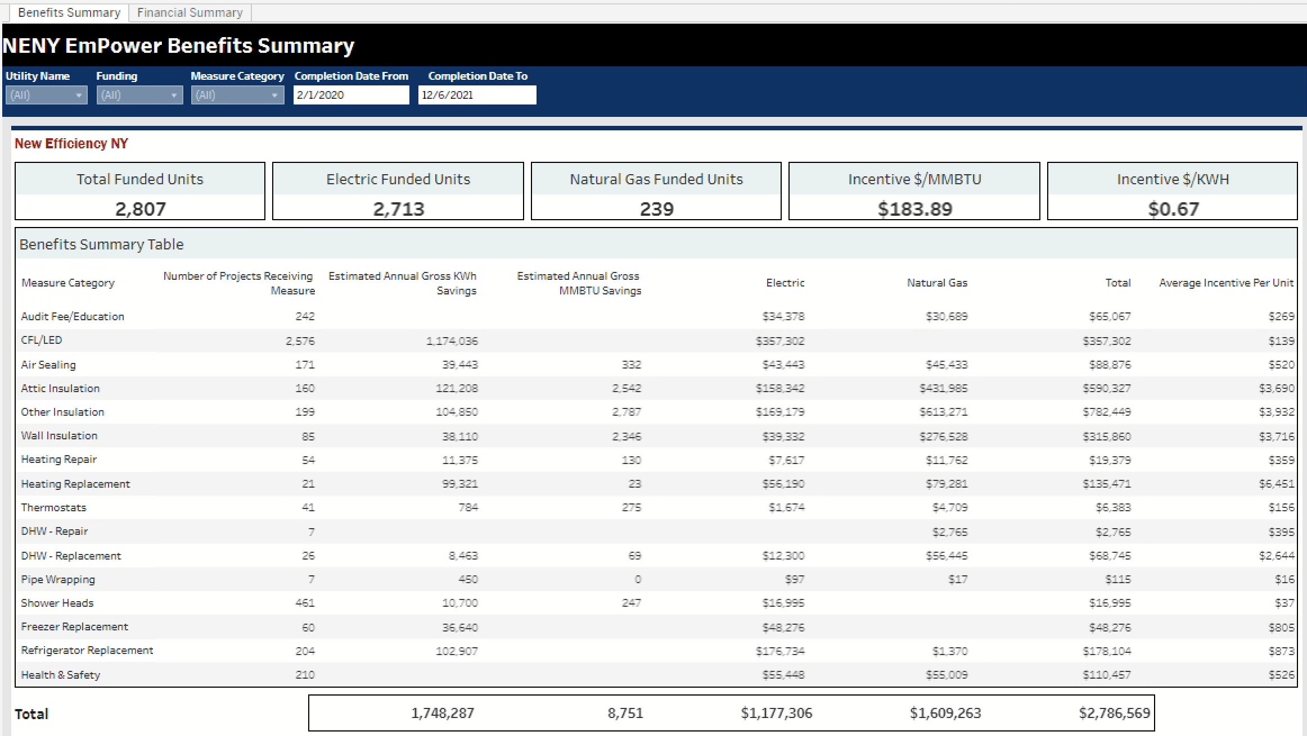
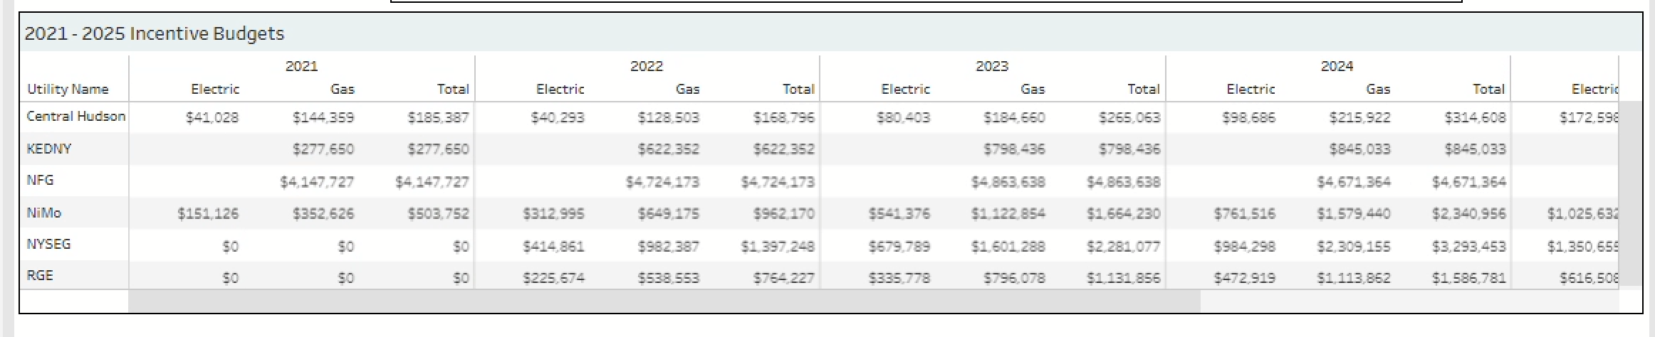
New Efficiency New York EmPower Reporting
Benefits Summary:
Pulls data from the Project database for completed work.
Does not contain PPSI
(Personal and Protected Sensitive Information)
Updated nightly
Downloaded data will only contain what is accessible from the report
Top Section:
  Summary of the total # of funded units
  # of units that received Electrical & Natural Gas funding from the New Efficiency New York Utility money
  Electric/Gas Incentives per/Gas Cost per/Kilowatt Hour cost
  Provides a Snapshot of their New Efficiency New York Funding that is administered through EmPower NY
  Additionally, can see a Measure level breakdown
  All data driven by when a Project is marked complete in the NYSERDA Partner Portal/Salesforce and relates to the Completion Date Filter
  Filters only effect this table and must be used to filter for the specific Utility
Bottom Section:
  Incentive Budgets data gets pulled from NEIS and provides a snapshot of what the expenditures are for a specific Utility compared to allotted budgets.

Slide 3
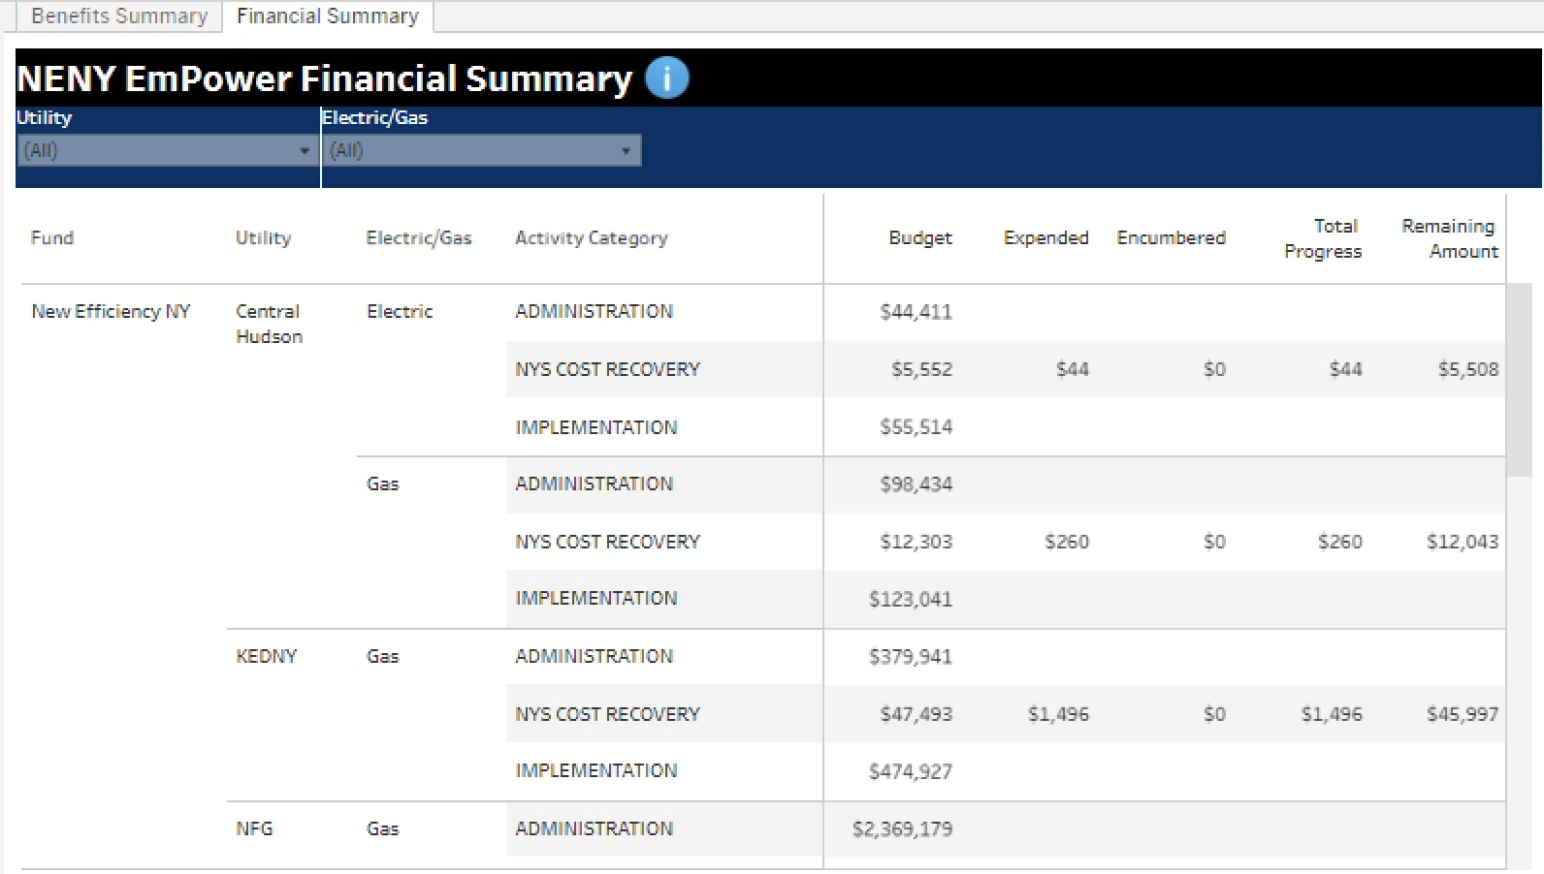
New Efficiency New York EmPower Reporting
Financial Summary:
Data comes from NEIS
Contains the budget information out of NEIS
Displayed with respect to how NYSERDA tracks New Efficiency New York funding:
  Administration
  Cost Recovery
  Implementation
  Evaluation (will be added later)
Provides an overview with respect to how a Utility is doing compared to budgets
  Budget
  Expended
  Encumbered
  Total Progress
  Remaining Amount
Filters can be used to filter the table.

Slide 4
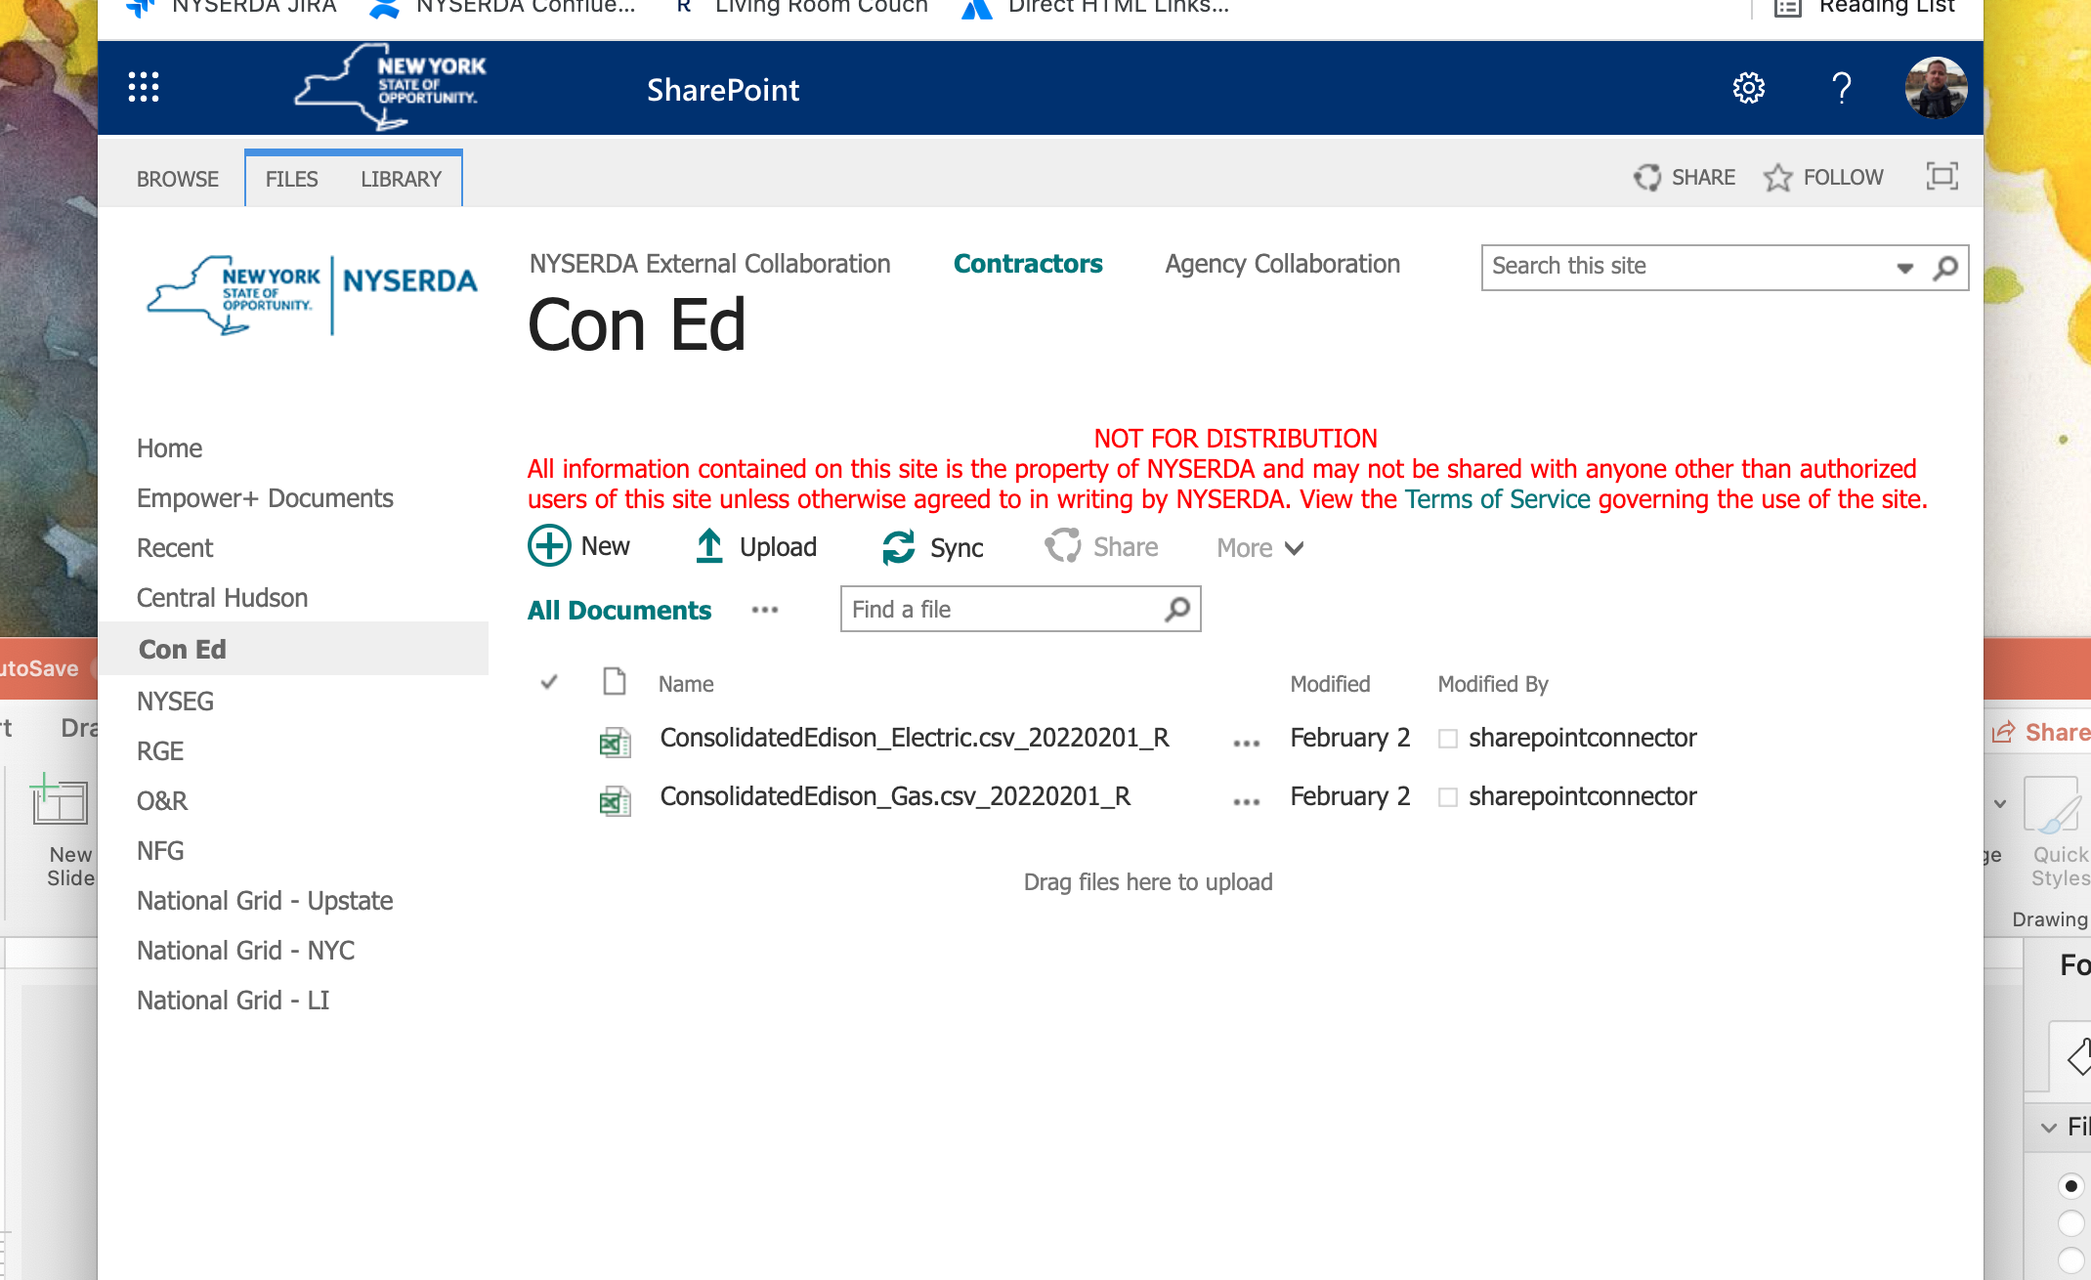
New Efficiency New York EmPower Reporting
SharePoint Reporting:
Can only see the document library associated with your Utility company.
Contains 2 reports:
  Electric Measures
  Gas Measures
Data comes from the NYSERDA Project Management software and will generate a .csv file with project specific information.
There reports DO contain PPSI which is why the reports were built within a protected environment.
Will contain data from all previous reports with new data added.
Updated once per month.
This data can be imported into the Utility’s own systems as needed or required.
Should be used to generate Quarterly Score Cards that are required as part of the DPS reporting requirements.

