Slide 1
Combined Residential Application
Updates and New Functionality for Utilities
02/24/2022
Utilities

Slide 2
Combined Residential Application Updates
NYSERDA Partner Portal Access
Utilities will be provisioned with access to our NYSERDA Partner Portal
When provisioned, Utilities will receive an email from Salesforce requesting they update their password.
Once updated, access has been granted.

Slide 3
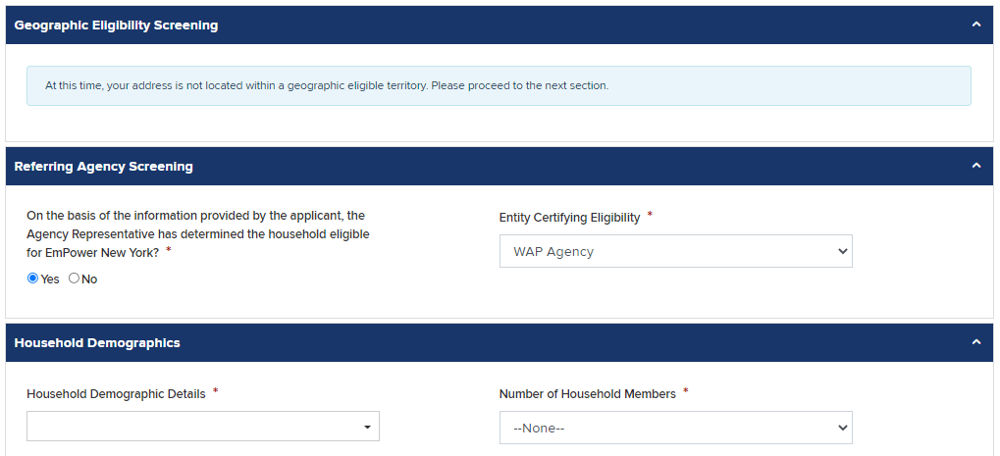
Combined Residential Application Updates
Updates to the online application:
Utility or other designated agencies, when submitting an application on behalf of a customer through their NYSERDA Partner Portal login, will see a new section on the Eligibility Screening page (Step 4) called Referring Agency Screening.
The Referring Agency Screening section asks if the Agency Representative has determined if the customer is income eligible for EmPower services.
If true, select Yes, then select Utility from the Entity Certifying Eligibility drop-down and proceed to the Household Demographics section.
If not, select No. The Referral Code Screening section will become visible, and the user will complete the rest of the eligibility screening sections like any other application. Shared Services will complete the review and determine eligibility.
The Referring Agency Screening section is immediately after the Geographic Eligibility Screening section but before any other eligibility screening sections.

Slide 4
Combined Residential Application Updates
Managing Users - Demo
Accessing Submitted Applications – Demo
Creating Campaign Codes - Demo

