Slide 1
Energy Affordability & Equity
Combined Application Training
July 2 & July 7
Participating Contractors

Slide 2
To provide process and system updates regarding the new EmPower/AHP Combined Residential Application for Program Services.

Slide 3
Combined Application Training
Introduction
Application Submission Options
Creating Campaign Codes
Salesforce Application Portal
Online Application Process
Application Review & Approval
Other Program updates
Additional Resources
Q&A

Slide 4
In this course, we will review relevant process changes to the EmPower New York (EmPower)/Assisted Home Performance with ENERGY STAR® (AHP) programs, including changes to eligibility and program requirements.
Additionally, we will introduce the new Combined Residential Application, highlighting specific application elements that relate to Program changes.

Slide 5
Introduction

Slide 6
Introduction
NYSERDA is pleased to announce the launch of the new Combined Residential Application on July 16th.
Previously, NYSERDA offered separate application for low-to-moderate-income households applying to EmPower New York or to Assisted Home Performance with ENERGY STAR®.
The new Combined Residential Application will be a single application (available online or paper) for all low-to-moderate-income households applying for incentives.
Through this session, we will walk you through the application process, identifying program changes where necessary to keep you informed as you work with Applicants.

Slide 7
Application Submission Options

Slide 8

Application Submission Options
Application Submission Options for Applicants
With the new, user-friendly Combined Residential Application, customers¹ can choose to complete and submit their application either Online or using a Paper Application.
Online and Paper Applications can be accessed from nyserda.ny.gov/ahp-empower².
Customers can begin the application online, then switch to paper later in the process.
  If they prefer not to e-sign the application and/or to mail the application in physically.
Applicants can receive assistance from Contractors and/or Community Organizations when completing applications.
  Contractors can complete the application on behalf of the applicant³.
Effective July 16, 2021, email application submissions will no longer be accepted.
  The Applications.Residential@nyserda.ny.gov email address will be disabled, and an automated response will be generated.
  Contractors, Community Organizations, or Applicants with scanned applications after this date will need to request that the Applicant complete and submit a new Combined Residential Application (Online or Paper)
    Paper applications should be mailed to:
    Energy Audit Application
    2 Wall Street,
    Albany New York 12205
  Only the new Combined Residential Application will be accepted for determining eligibility for new applicants to the Assisted Home Performance or EmPower New York programs.
Applicants are prohibited from submitting empty applications to the Program directly.
Online application mandates Data entry for completion and submission online or mail it to the address shown above.
Notes:
1: Customer’s should be the Occupant of the Home, who should be the parties applying for the program. This is a change for AHP and more closely resembles the EmPower NY process.
2: The website shown on this slide will be active as of July 26th, 2021.
2: This requires that the Contractor obtain a signed copy of the application from the Applicant. Contractors must also upload the signed application to the online application prior to submission.

Slide 9

Application Submission Options
Application Submission Options for Applicants – Campaign Codes
With the Combined Residential Applications, CLEAResult Shared Services, Contractors, and Community Organizers can create Campaign Codes from their Salesforce Application Portal.
  Campaign codes provide alternative options for Applicants to access the Online Application.
CLEAResult Shared Services will have the ability to create campaign codes for Utilities and share the code with Utility partners.
Creation of campaign codes will be done in Salesforce (migrated from Uplight).
Once a campaign code is created, a web link will be generated that can be posted to a website or shared with an applicant through email.
Applicants applying using the online Combined Residential Application from an active campaign code generated web link, will see the contractor and/or community organization’s information pre-populated in the Partner Information section of the application.
Contractors and community groups can set up multiple campaign codes to track different marketing outreach efforts through Salesforce.
Utilities:
NYSERDA will work with each Utility to create Campaign Codes and will train Utilities on how to track Campaign Codes through Salesforce.

Slide 10
Application Submission Options
Benefits of the Online Application (vs. the Paper Application)
Faster, Safer, and More Accurate:
Its the fastest path for reviewing and approving an AHP or EmPower applicant.
Reduces or prevents incomplete, incorrect or missing information in the application.
Sensitive documents (proof of income, utility bills) in any format (pdf, photo) are uploaded securely.
Applicants can provide an e-signature rather than a physical one.
Approved applications automatically and seamlessly upload into Uplight to auto-create projects.
More Control:
Applicants can choose their own Contractor² if they own the property referenced in the application.
Applicants can start, stop and return to the application at anytime which is helpful if¹:
  The application cannot be completed in one setting,
  Additional time is needed to gather required and/or supporting documents or information
More Reliable Communications:
NYSERDA staff can leverage the online application to quickly reach out to applicants directly for missing documentation or information.
The system the application is built around provides timely, automated reminders and notifications to applicants when communication is necessary.
  Reminders are sent at day 10 and 20 once an application has been initiated.
  Manual cancellation of the application occurs at day 30.
Notes:
Applicants must complete the first page of the Online Application and save their work to enjoy this benefit. Additionally, this requires that the Applicant creates a Salesforce Application Portal account.
Program will do their best to accommodate an Applicant’s selected Contractor but here may be limitations that prevent an Applicant's choice from being selected to accept the project.

Slide 11




Application Submission Options
While the Combined Residential Application is meant to streamline and simplify the application process, NYSERDA still requires a minimum amount of information to approve applicants.
Customer Information
Utility Information
Partner Information
Income Documentation
Name
Address
Mailing Address
Building Type
Electric Utility Account Numbers
Heating Utility Account Numbers
Preferred Contractor
Community Organizations
  (If the Applicant leveraged assistance while completing the application)
Individual documentation is not required for applicants who meet any of the below:
Address is in a Geo-eligible pre-screened area
Receives a Referral Letter¹
Participates in²:
  HEAP
  Food Stamps
  SSI
  TANF
  Public Assistance
Notes:
1: Applicants must provide this Referral Number as part of the application.
2: Applicants participating in HEAP, Food Stamps, SSI, TANF, or Public Assistance must upload an award letter (within the last 12 months) to the application.

Slide 12
Creating Campaign Codes

Slide 13
Creating Campaign Codes
Campaigns are created in Salesforce using the Generate Campaign tab.
Portal Users will be able to review all previous Campaign Codes they generated from within this tab.
Old Campaign Codes should have their status set to Inactive when no longer needed.
Campaign Code creation generates an associated URL that can be used in websites or through email.
Applicants leveraging a Campaign Code URL to apply will see the Campaign Code’s associated Contractor pre-selected within the application.

Slide 14
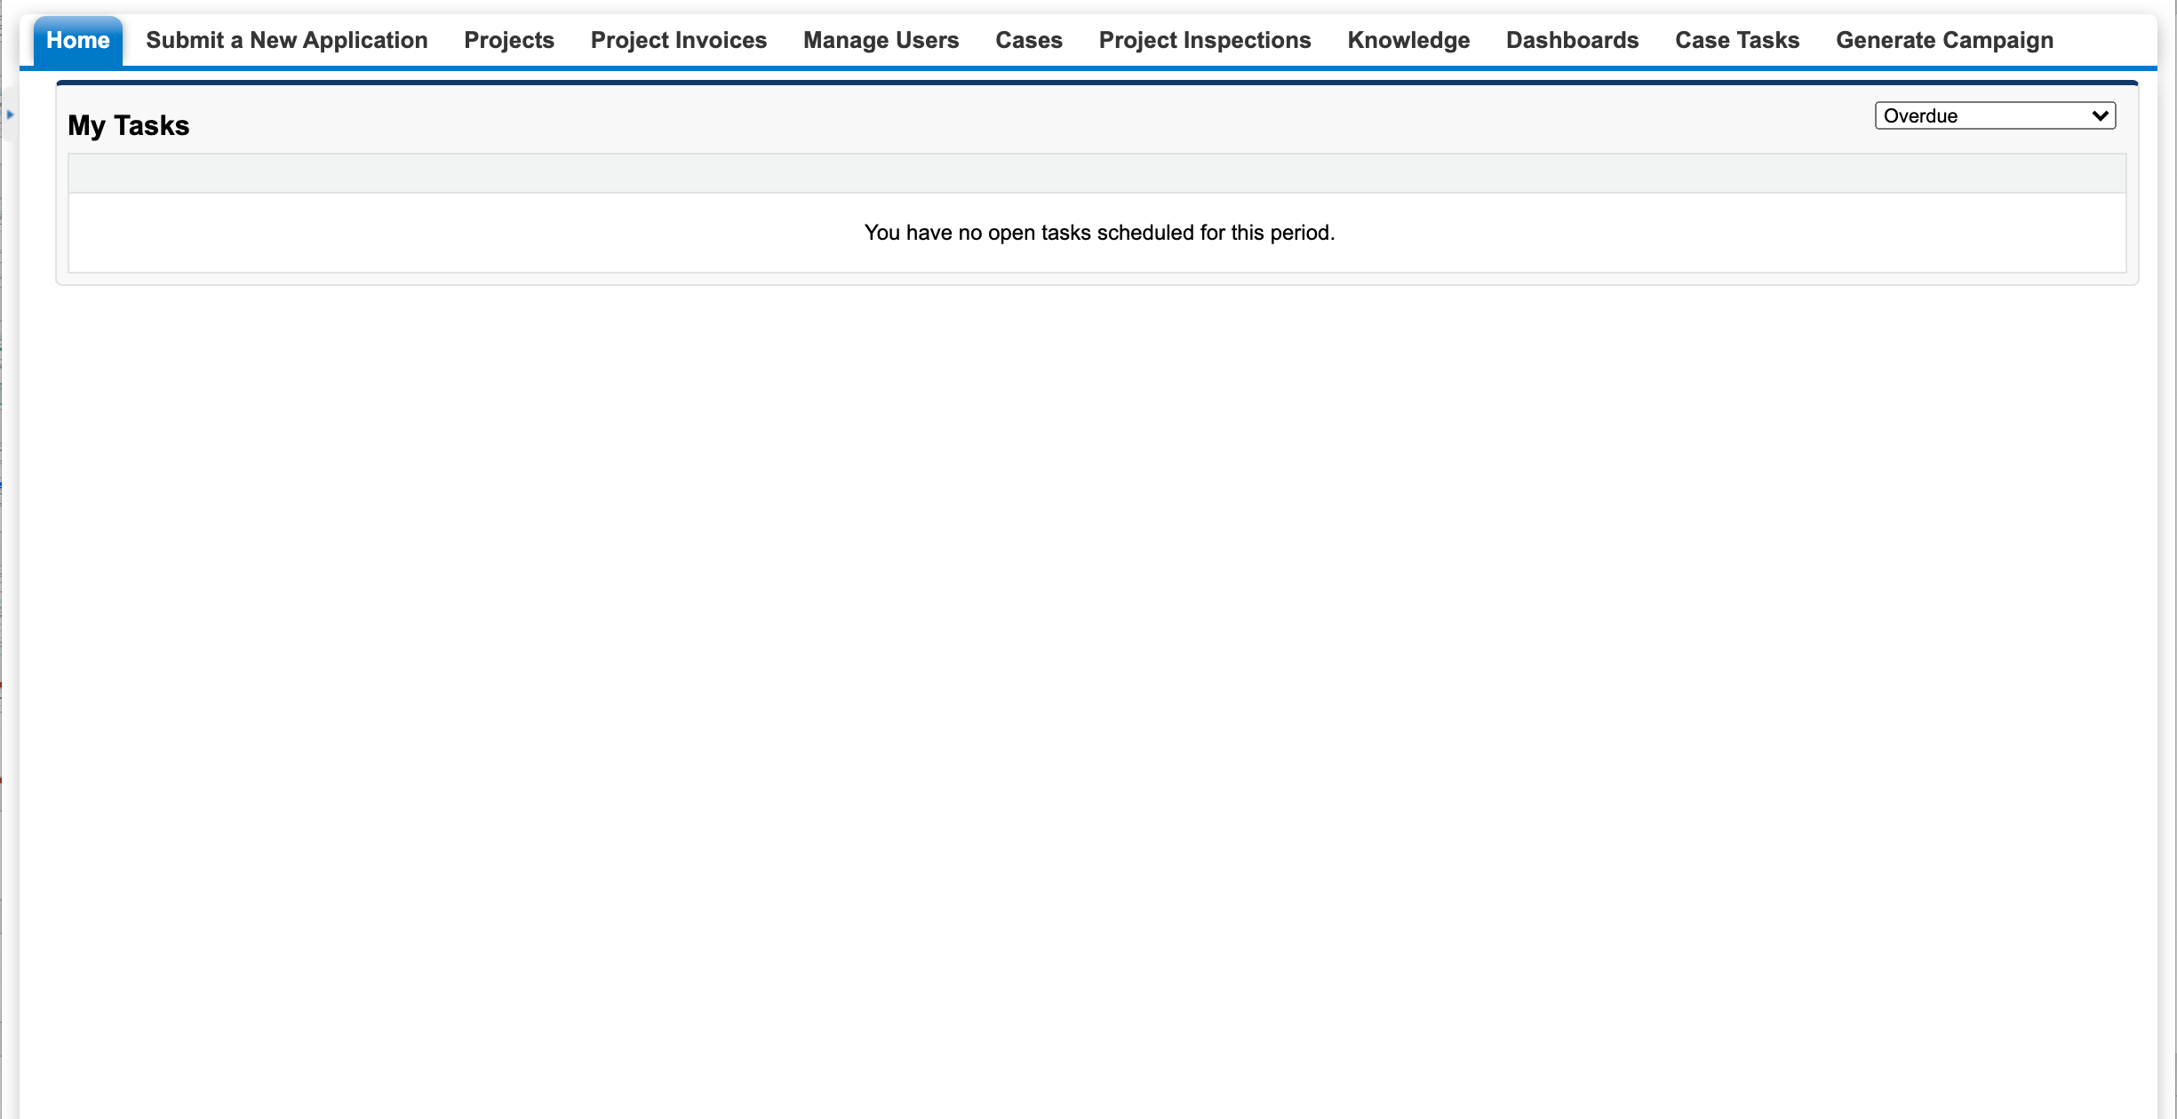
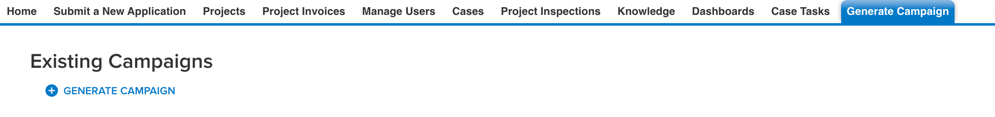
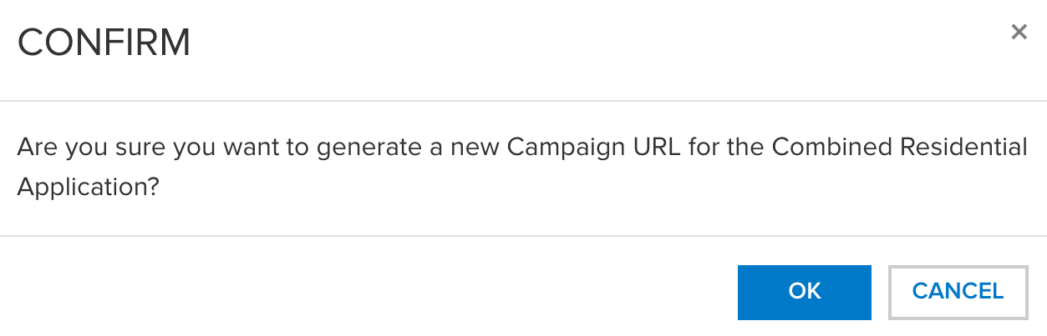
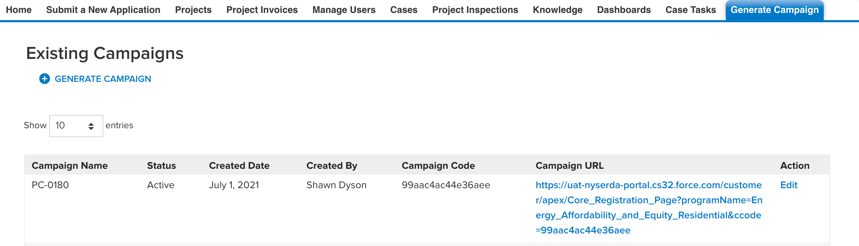
Creating Campaign Codes
To create a Campaign Code:
Access the Generate Campaign tab from Salesforce
Click on the Generate Campaign link.
Confirm the Campaign Code creation on the modal window.
Copy and paste the URL that was generated for the Campaign Code for use in websites or through email.

Slide 15
Salesforce Application Portal

Slide 16
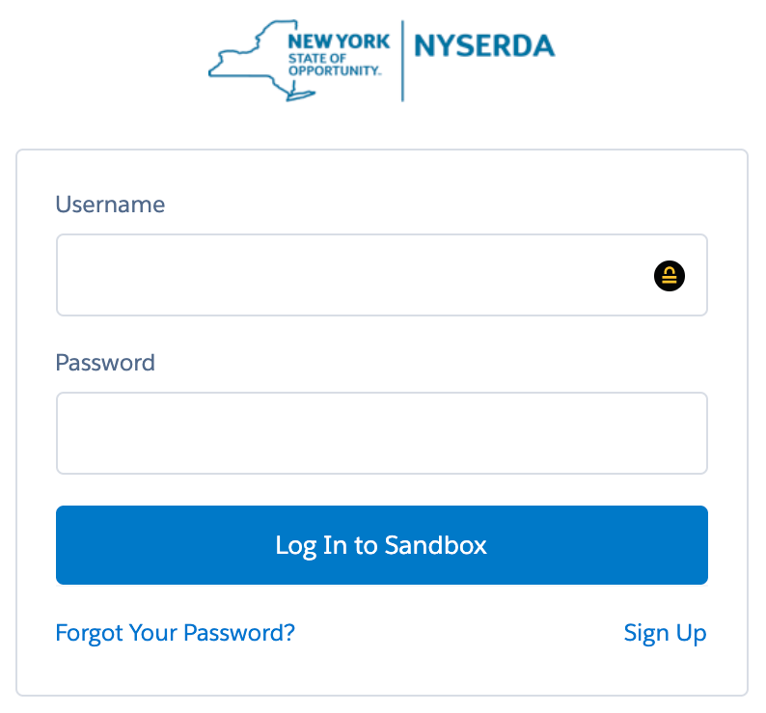
Salesforce Application Portal
Applicants are required to create a Salesforce Application Portal account to use the Online Application¹.
A Salesforce Application Portal account provides multiple methods of communication:
Notes & Attachments:
Allows Applicants to communicate with the NYSERDA program (even after application submission).
Allows Applicants to update information or documents in their application.
Chatter Feed:
Allows Contractors to communicate² with the NYSERDA Program and Program Implementation (even after application submission).
Notes:
1: Only if a Contractor will not be using a Paper Application to enter and submit online on behalf of the Applicant.
2: Any information entered in the Chatter Feed is reviewed during the Application Review phase. Responses will leverage the Chatter Feed as well.

Slide 17
Salesforce Application Portal
Participating Contractors
Community Energy Advisors
User access is managed at the Company level. Access must be granted to an individual.
(group accounts are not allowed)
  Managing User Access
Users under the same company profile will have access to the application data once:
  Customer submits the application for review and project is assigned to the contractor.
  Customer selects a specific contractor or is entered via campaign and upon application approval.
Each company will be responsible to maintain user access to their company profile.
Sensitive data will be hidden once the application is submitted and will no longer be accessible.
User access is managed at the NYSERDA level. Access must be granted to an individual (group accounts are not allowed).
Users under the same organization profile will have access to the application data as soon as a customer saves the application, regardless if completed or not. Requires the following:
  All users to sign a Non-Discloser Agreement.
      Copies of the NDA have been distributed. Contact your NYSERDA Manager if you need them resent.
  Regularly updating Salesforce user profiles/access rights through your NYSERDA Manager.
Sensitive data and uploaded documents will remain available.

Slide 18
Online Application Process

Slide 19
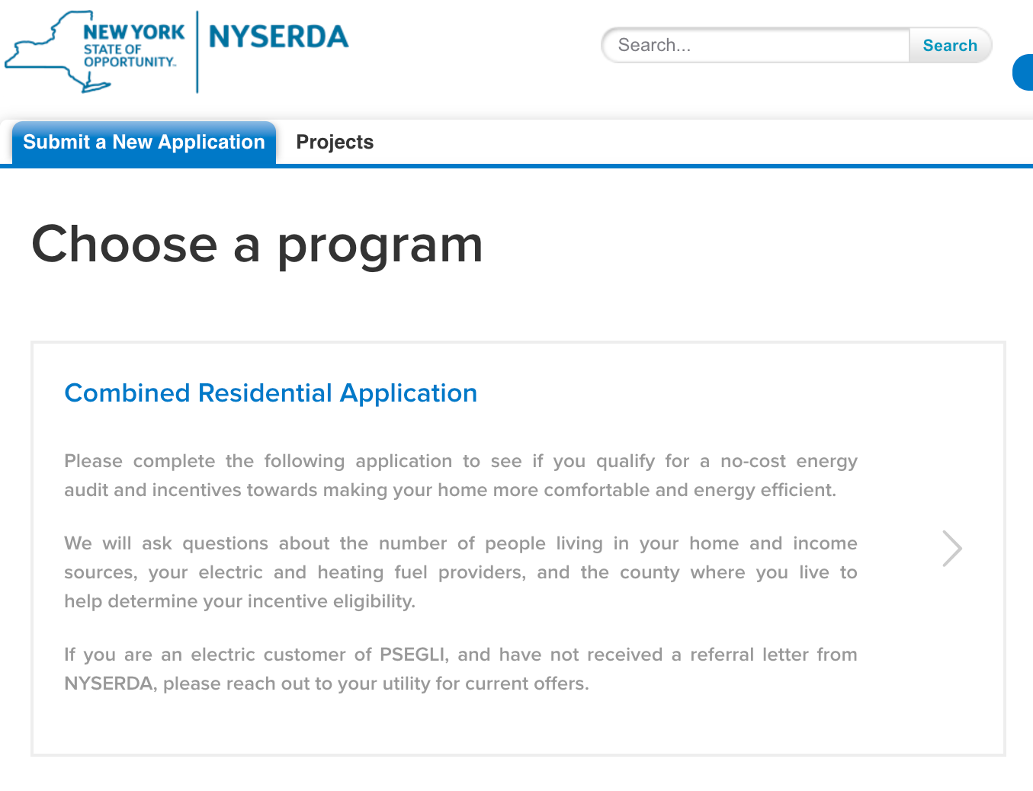
Online Application Process
The Combined Residential Application (Online or Paper) is accessed from nyserda.ny.gov/ahp-empower.
It can also be accessed from an Applicant’s Salesforce Application Portal.
  Once in the Portal, click the Combined Residential Application option in the Submit a New Application tab.

Slide 20
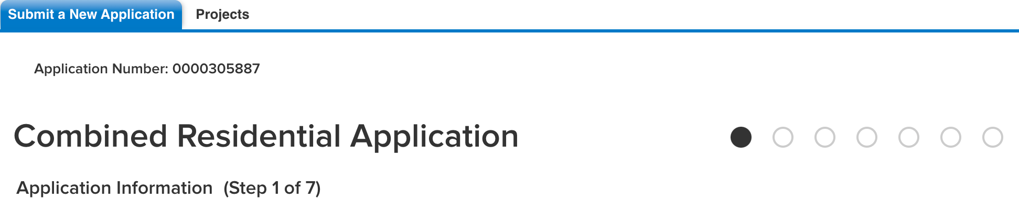
Online Application Process
The Combined Residential Application contains seven (7) steps (pages) that navigate Applicants through the application process.
Each step (page) contains:
  A series of fields and information that must be provided.
  (Required fields are denoted with a red asterisk.)
  Instructional text at the top of the page to provide additional clarity regarding the application and requested information.
  (We recommend all Applicants review this information before entering information on any step (page)
Application progress can be Saved on each step (page) by clicking the Save button¹.
Step 1 | Step 2 | Step 3 | Step 4 | Step 5 | Step 6 | Step 7
Applicant Info | Utility Info | Partner Info | Eligibility Screening | Review Application | Project Documents | Submission
Notes:
1: The Save button appears on the bottom of every page in the application process.

Slide 21
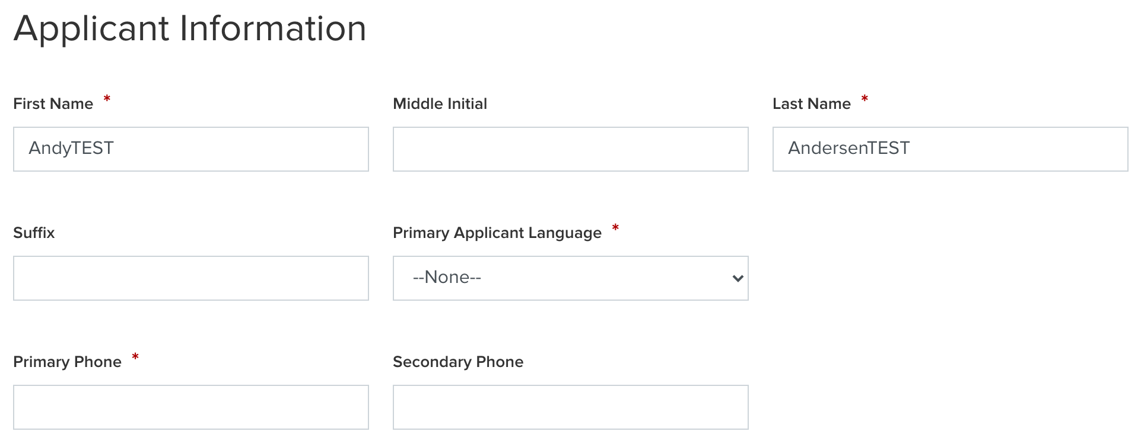
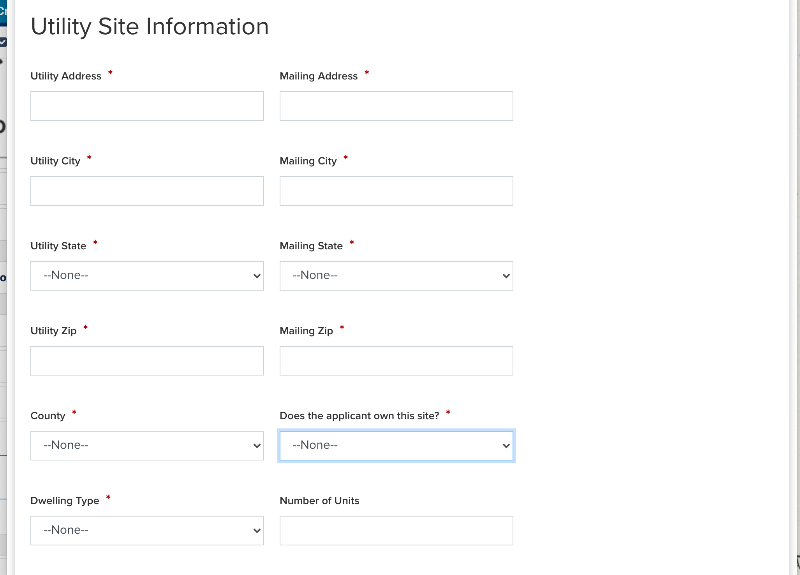
Online Application Process
Step 1 (Page 1)
Applicant and Utility Site Information
Applicants provide their personal information (Applicant Information) along with the properties' physical and mailing address(es) (Utility Site Information)
For the Utility Site Information section, Applicants must also document if:
  They own the property with the address provided,
  What type of dwelling exists on the property, and
  The number of units within the dwelling¹.
Applicant First Name
Applicant Last Name
Notes:
1. The Number of Units field becomes a Required field if Multi Family (5+ units) is selected as the Dwelling Type.

Slide 22
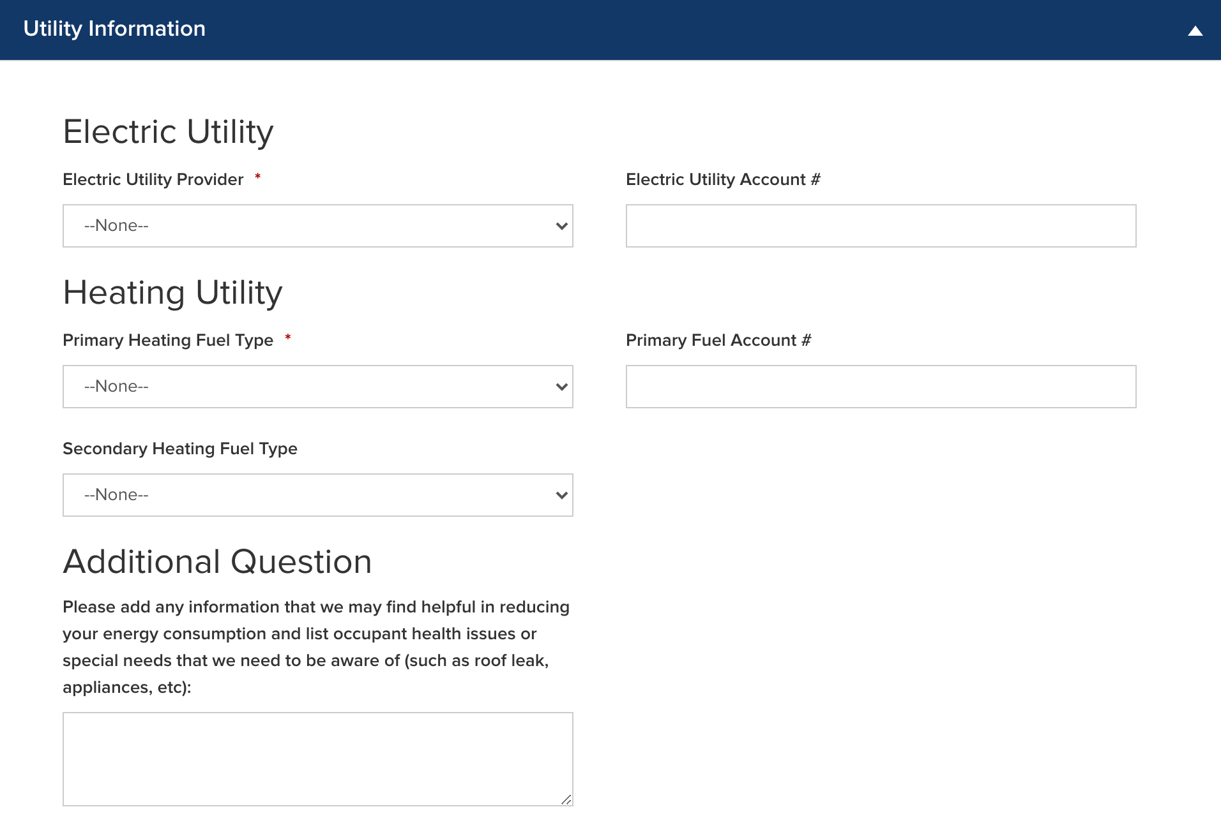
Online Application Process
Step 2 (Page 2)
Utility Information
Applicants provide their Electric and Heating Utility company names as well as their associated account numbers.
  While the Utility Account numbers are optional fields, Applicants who provide this information will receive the most accurate and effective recommendations for work that will be performed at the site.
Additional Question
This additional section on this page provides an opportunity for Applicants to note any additional information that may help NYSERDA reduce energy consumption or risks to occupant health or special needs.

Slide 23
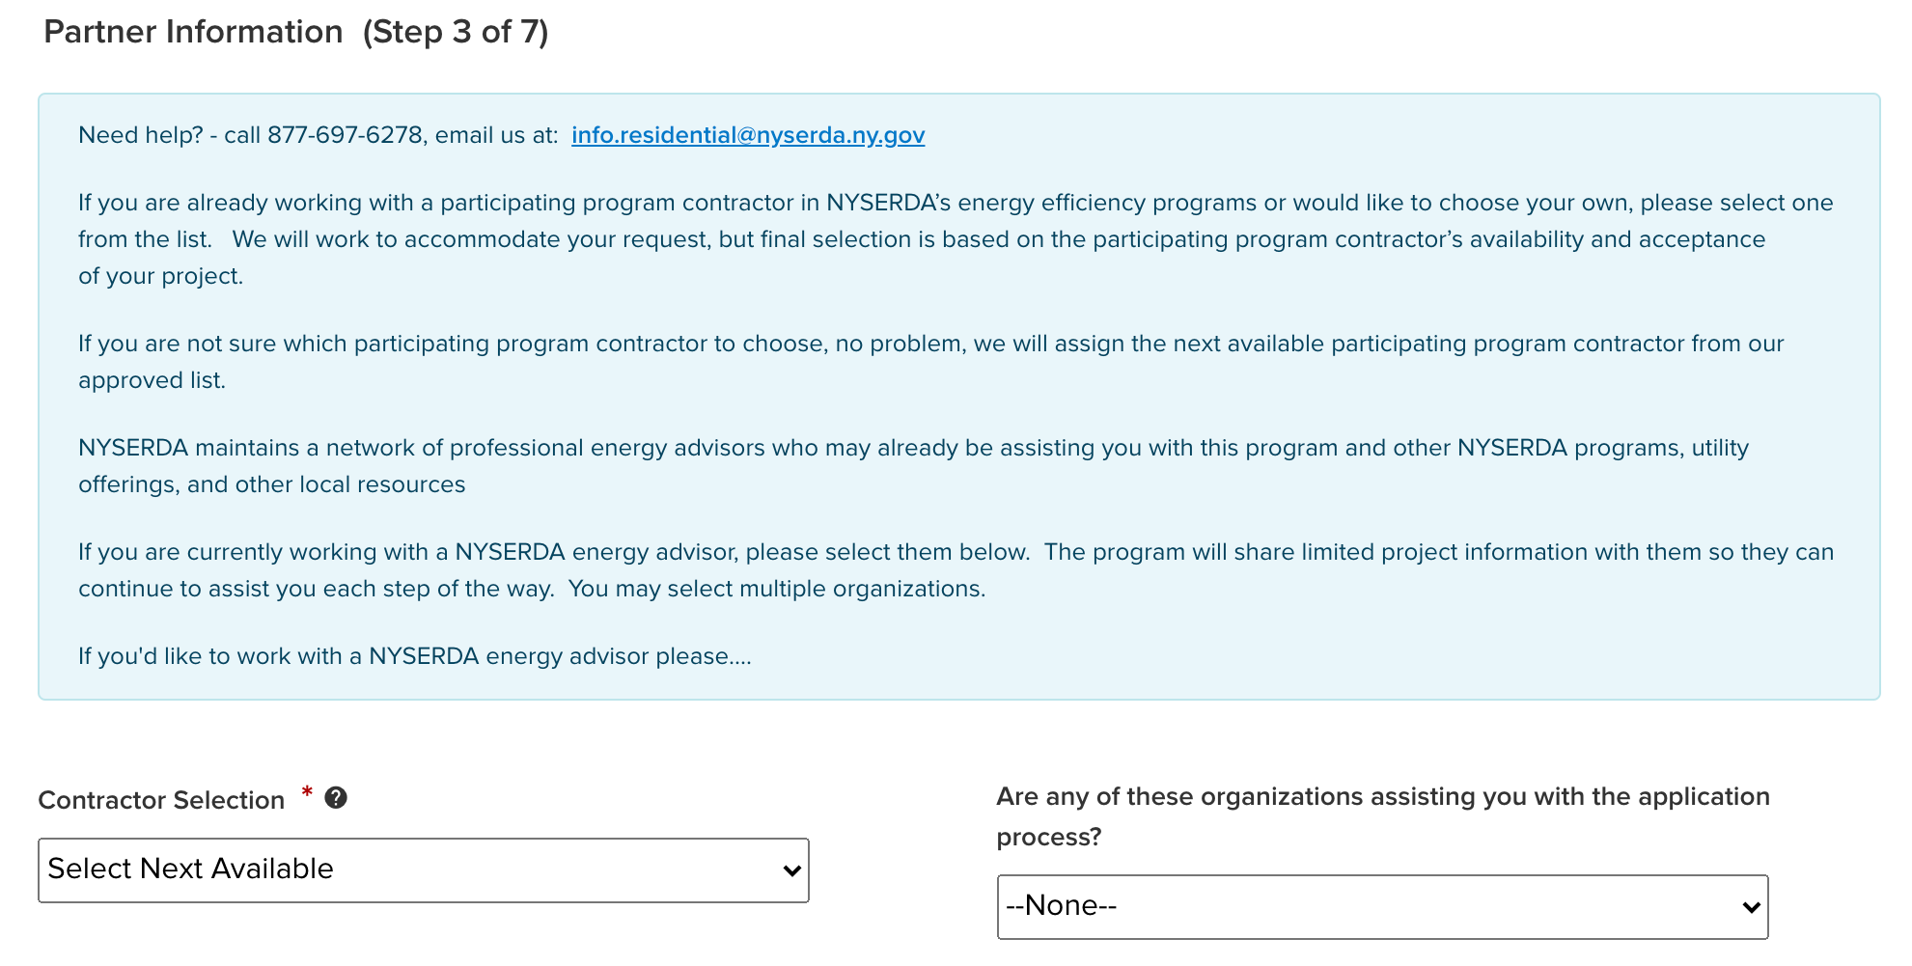
Online Application Process
Step 3 (Page 3)
Partner Information
Applicants can choose a Contractor¹ and/or a CEA if they have already been working with one or if they have a preference.
CLEAResult Shared Services selects Contractors¹ when paper applications are submitted or if the Applicant did not select one when applying.
  Contractors/CEAs may pre-fill their name on the paper application.
The Contractor selected on the application will be assigned the project via Uplight, whenever possible.
CLEAResult Shared Services will continue to assign referrals as done today until Contractors can manage their respective referral intake/capacity in Salesforce (phase 2).
If a Contractor does not accept a project within Uplight, the project returns to the Application Approval phase and requires CLEAResult Shared Services to assign an alternate.
Notes:
1: Final Contractor selection is based on the participating program Contractor’s availability and acceptance of the project.

Slide 24
Online Application Process
Step 3 (Page 3)
Partner Information Continued
When a Campaign Code is used, the associated Contractor or CEA will be selected systematically.
Applicants can choose an alternate Contractor or CEA in this scenario on the Partner Information step (page).
Contractor List Generation
Phase I (July 16):
  Service territories have been aligned with the most current information NYSERDA has on file from your Participation Agreement.
  Contractor names will be surfaced and randomized based the applicant’s service address.
  Referrals will be assigned to the next contractor on this list.
Phase II Enhancements (Late 2021):
Contractor On/Off Project Acceptance enables a Contractor to temporarily omit their name from the selection list when at capacity or does not wish to receive referrals.
Fully automated Round Robin selection implementation where the system assigns to the next contractor in line.

Slide 25
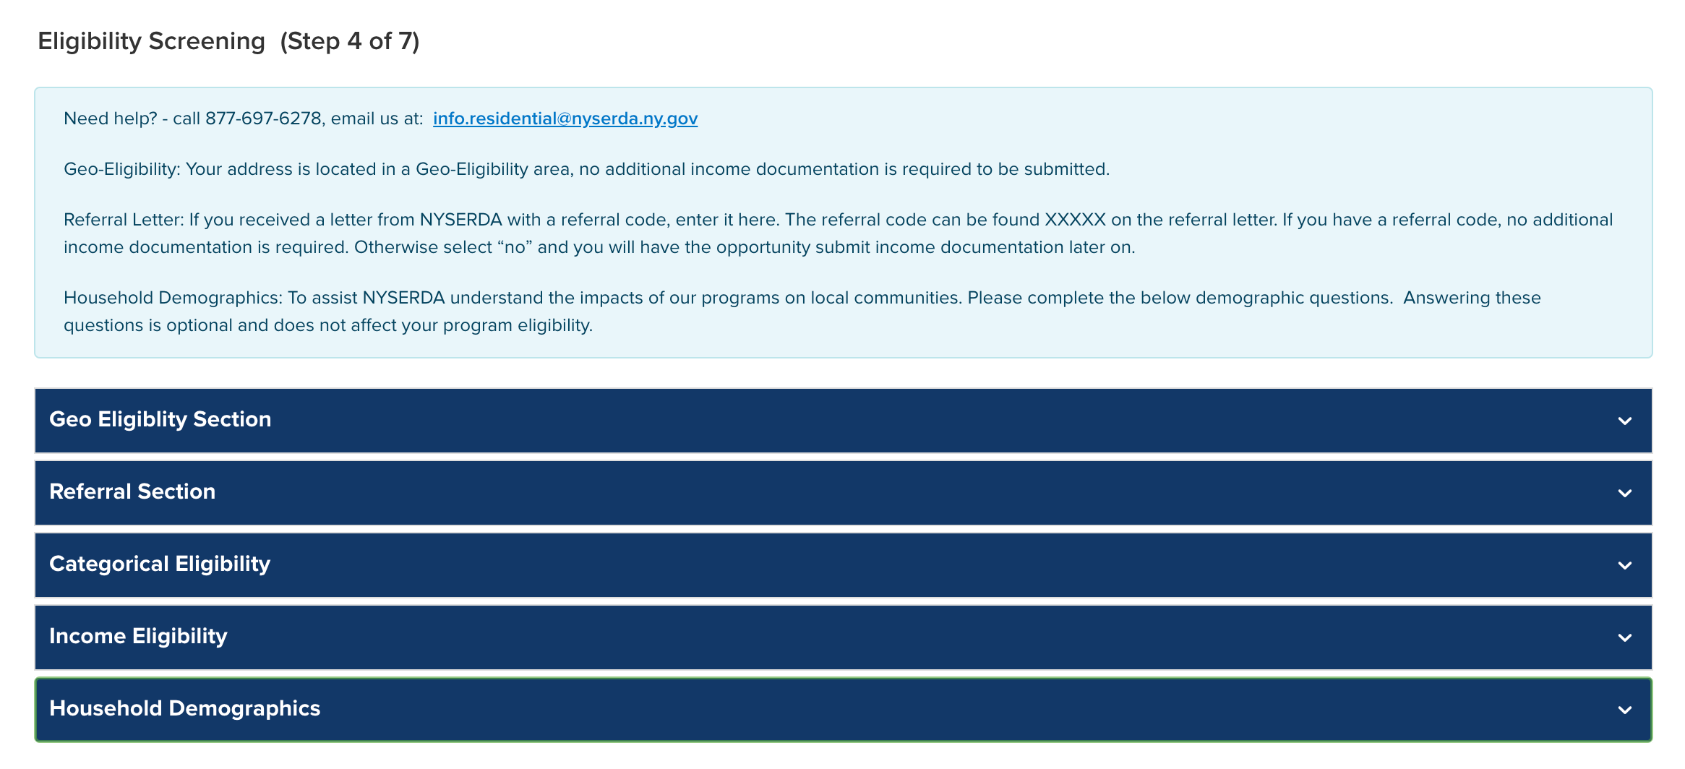
Online Application Process
Step 4 (Page 4)
Eligibility Screening¹
Applicants need only satisfy one Eligibility Requirement.
Geo-Eligibility is determined automatically by the system based on the Applicant’s address for low-income customers.
  Geo-Eligible map will be provided available on NYSERDA’s website, when available.
  Geo-Eligibility for Moderate Income Applicants is discontinued.
Applicants with a Referral Code² should enter the code in the Referral Section.
  Referral Codes are provided through Welcome Letters or Emails to the Applicant.
  Referral Codes eliminate the need for Income Documentation.
Applicants who receive HEAP, SNAP, SSI, TANF, or Public Assistance need only provide the associated Award Letter.
  No other household residents will be required to submit proof of income if the above applies.
  Once an Applicant’s income is reviewed and eligibility determined, their application will proceed along the corresponding workflow within Uplight.
If none of the above applies, Applicants must provide proof of income for all household members 18 and older who are not full-time students.
Notes:
1: CLEAResult Shared Services reviews all submitted applications and determines what an Applicant’s eligibility qualifies them for.
2: Applicants using a Referral Code not associated with their Name/Address will be requested by the Program to submit additional proof of income. The application will be placed on Hold in the system until proof of income is obtained.
Last Note:
Demographic Information: While demographic information is not used for determining program eligibility, NYSERDA requests applications complete this section for statistical purposes. Applicants may choose “prefer not to answer”

Slide 26
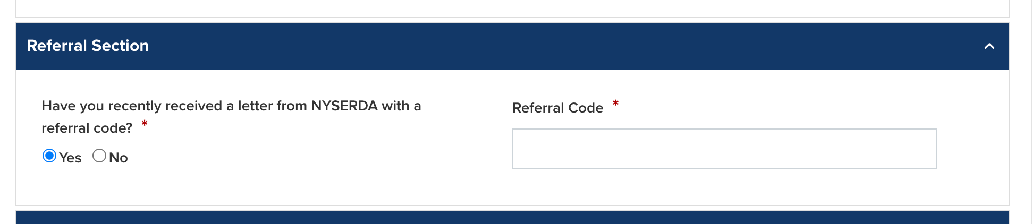
Online Application Process
Step 4 (Page 4)
Referral Eligibility Continued
NYSERDA will continue to send out referrals to EmPower eligible households.
NYSERDA currently receives referrals from the Utilities and the Office of Temporary and Disability Assistance (OTDA).
NYSERDA has traditionally sent out applications to referral households through US mail for completion and to return to the program.
NYSERDA will continue to mail referrals with applications¹.
  If referral data received by NYSERDA includes an email address, NYSERDA will send an email to the referral household along with information on how to access the Combined Residential Application.
As part of the application process, referral households will be asked to provide their referral ID.
  This ID will be referenced in the letter/email sent to the referral household. If an applicant provides a referral ID, they will not need to provide additional income verification as part of the application process.
  Contractors and Community Organizations working with applicants should inquire if a NYSERDA referral letter or email was received and provide clarity on where to enter the referral ID to expedite the application process for the household.
Notes:
1: NYSERDA is exploring various outreach methods to referral households to see which forms of outreach result in the best return percentage of completed applications

Slide 27
Online Application Process
Step 4 (Page 4)
Categorical Eligibility Continued
Acceptable Categorical Eligibility Documents:
Categorical Eligibility Type | Document | Acceptable Date Range
HEAP | Award Letter | Awarded within last 12 months
SNAP | Award Letter | Awarded within last 12 months
TANF | Award Letter | Awarded within last 12 months
Supplemental Security Income | Award Letter or Benefit Statement | Awarded within last 12 months

Slide 28
Online Application Process
Step 4 (Page 4)
Income Eligibility Continued
Acceptable Income Eligibility Documents
Important Notes:
Income Eligibility Documents should include all sources of income for each household member who is 18 years of age or older and who is not a full-time student.
If a household member has multiple sources of income, add a separate line item for each income source.
Applicants can choose to use tax returns instead. Applicants can only use this option if all members of the household who were required to file a tax return did so. Additionally, all sources of income must be documented within the tax return for each household member.
Tax returns must be the most recent Federal Income Tax Return (Form 1040, 1040A, or 1040EX)
If documenting Rental, Business, or Farm income, Applicants must submit corresponding schedules (C, E, and F)
Income Type | Document | Acceptable Date Range
Social Security | Award Letter or Benefit Statement | Within 12 months
Social Security Disability (SSD) | Award Letter or Benefit Statement | Within 12 months
Pension | Pension check stub showing gross amount or letter from Pension Board | Within 12 months
Disability (Short Term or Long Term) | Benefit Statement | Within 60 days
Child Support / Alimony | Court Award Letter or printout from domestic relations | Within 12 months (within 60 days if using printout from DR website)
Foster Care Payment | Statement from Social Services | Within 60 days
Workers Compensation | Award Letter or Benefit Statement | Within 60 days
Unemployment | Letter of Determination | Within 60 days
Veterans Benefits | Award Letter or Benefit Statement | Within 12 months
Annuities | Bank Statement | Within 60 days
Salaries/Wages | Pay Stubs | Four weeks of paystubs from the last 60 days
Interest Income | Bank Statement | Within 60 days
Rental Income | Current Lease or Rent Receipt | Within 12 months
Business or Farm Income | Tax Return, IRS Report of Quarterly Earnings, business records. | Tax Return: Previous Year IRS Report: Previous 3 months Business Records: Previous 3 months
Tax Documentation | Form 1040, 1040A, or 1040EX | Most recent year tax return

Slide 29
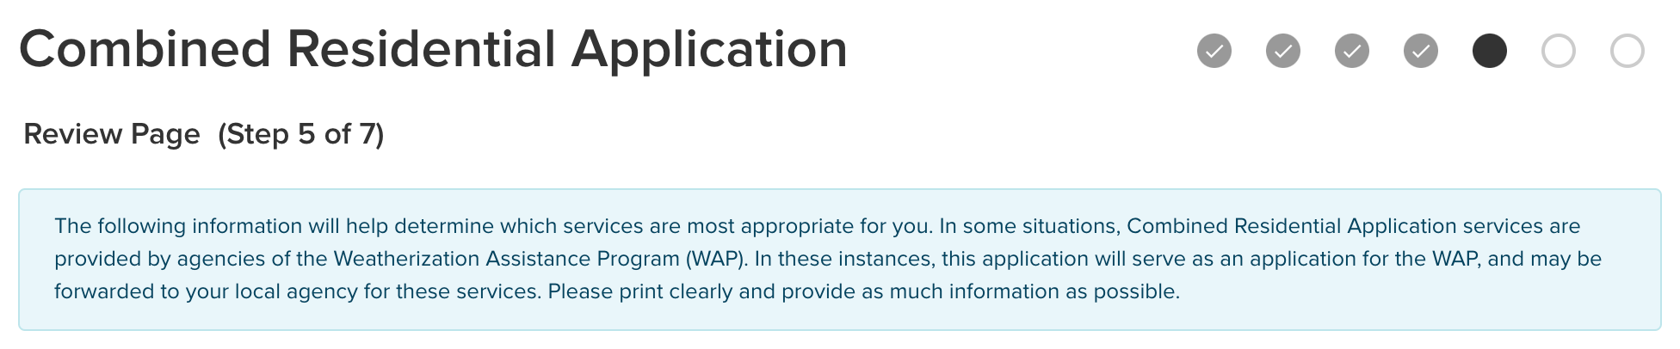
Online Application Process
Step 5 (Page 5)
Review Application
Applicants review their application information before submission.
Provides mechanism to capture an Applicant’s E-Signature through DocuSign.
E-Signatures are not required, however, mailing an application will significantly delay the process.
Emailed applications will no longer be accepted.
Applicants who choose to hand sign can print the application at this stage of the process, hand sign, then either:
    Scan the completed and signed application and upload to the Online Application, or,
    Mail the application to:
    Energy Audit Application
    2 Wall Street,
    Albany New York 12205

Slide 30
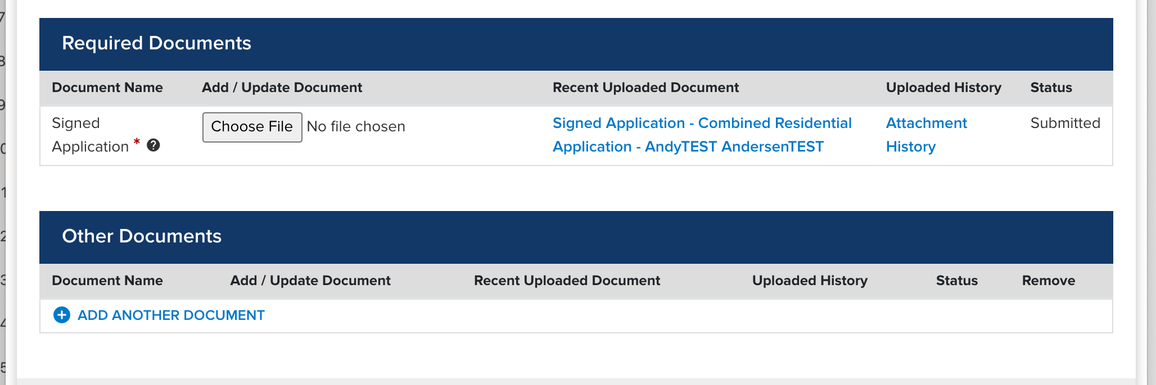
Online Application Process
Step 6 (Page 6)
Project Documents
Allows Applicants to upload required documentation to their application.
Applicants who chose to hand sign and scan their applications can upload them at this stage of the process.

Slide 31
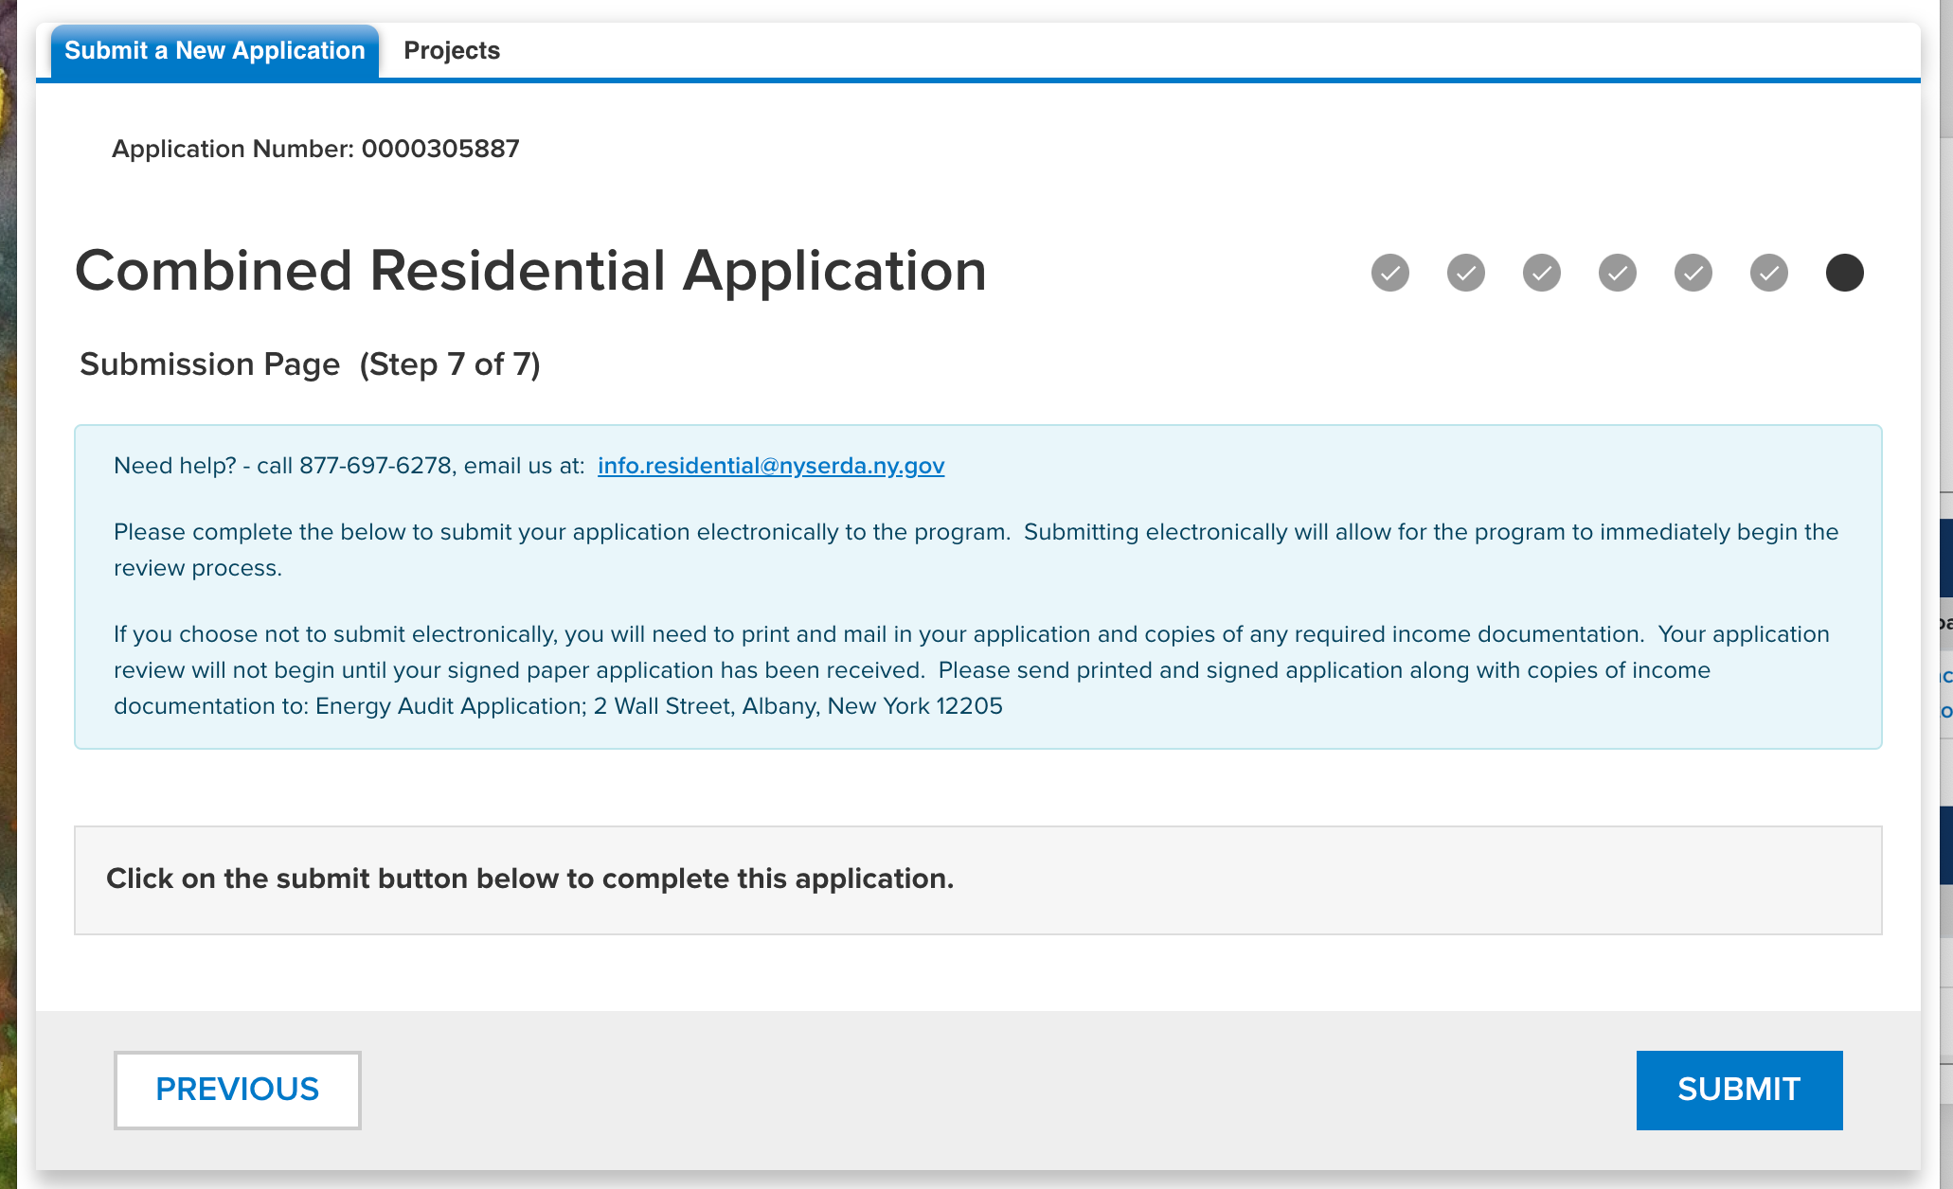
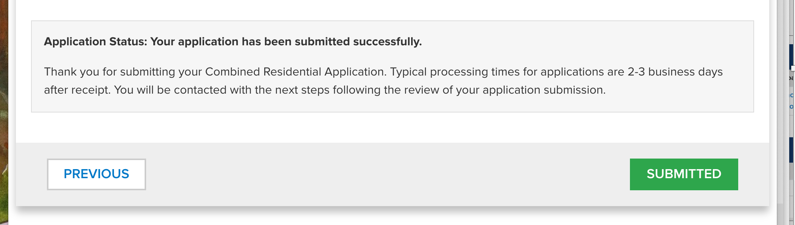
Online Application Process
Step 7 (Page 7)
Application Submission
This is the final stage of the Application Submission process.
Applicants should click Submit to complete their application.
Approved applications will then be reviewed by CLEAResult Shared Services for accuracy and completion.

Slide 32
Application Review & Approval

Slide 33
Application Review & Approval
Salesforce evaluates if the Applicant received prior Program services within the last 3 years.
  Applicants who have exceeded the $10,000/3 year cap are ineligible for the Program.
Applications¹ are reviewed by CLEAResult Shared Services in Salesforce.
  Paper Applications are entered into the system first by CLEAResult Shared Services².
  Moderate-income applications will no longer be submitted to SlipStream (EFS) for review/processing.
  All Moderate-income projects will be sent to the Express Audit workflow in Uplight.
    When completing an Express Audit for a customer, create the project within the Express Contract Workflow.
  All Low-income projects will be sent to the EmPower workflow in Uplight
CLEAResult checks for the following:
  Applicant’s information is complete
  Income eligibility (to help determine the appropriate program for the Applicant)
Applications with missing required information are placed on-hold³
  Applicants who provided an email address receive an automatic email reminding them to complete their application.
  (sent twice, at 10 days after initial submission and again at 20 days after initial submission)
  Applicants who did not provide an email address will receive a mailed letter reminding them to complete their application.
Applications still missing required information after the required timeframe will be re-reviewed for next steps.
  This could result in a cancelled application
  Rental projects without Landlord approval are assigned as direct install projects.
Notes:
1: Traditional EmPower and Assisted Home Performance (AHP)
2: After Paper Applications are entered into the system by CLEAResult Shared Services, Paper Applications follow the same review process as Online Applications.
3: Applications placed on-hold go into an On-Hold Queue in Salesforce.

Slide 34
Application Review & Approval
Interim Project Processes
Project Type | Application | Project Creation & Assignment | Contractor Project Steps
EmPower | Combined Residential Application | Program Team determines eligibility from application and creates project in EmPower workflow. | Follow current processes.
AHP with Audit¹ | Combined Residential Application | Program Team determines eligibility from application and creates project in Express Audit workflow. | Complete audit submission beginning at Audit Claim Stage Presented with the option to create a follow-on Express Contract project in the NY HP Portal per the current process.
AHP Only^{2,3} | Combined Residential Application | Program Team determines eligibility from application and crates project in Express Audit workflow OR Contractor creates project in Express Contract workflow (eligibility determined at Subsidy Approval Stage) | Utility & Incentive Stage Answer “No” to question “Is this project pursuing financing?” Add note to indicate that project is a Coordinated EmPower/AHP project and provide the EmPower Project ID. Final Project Documents Stage Discontinue use Eligibility Screening Report (ESR), use new Certificate of Completion.
Coordinated EmPower & AHP | Combined Residential Application | Program Team determines eligibility from application and creates project in Express Audit workflow AND Contractor creates project in Express Contract workflow | EmPower – Follow current processes AHP – Follow adjusted steps above for AHP Only
Notes:
1: Projects are assigned:
A: To the Contractor submitting the project,
B: To the Contractor selected by the Applicant, or
C: Per the current referral process.
2: An Audit is not required to be submitted during Project Creation & Assignment
3: Financing no longer goes through EmPower or AHP. Proformas and other required documentations should be submitted directly through Slipstream/EFS.

Slide 35

Application Review & Approval
Project Completion:
New Certificate of Completion (CoC) has been developed and replaces the following:
  Certificate of Completion, Post-Installation Health and Safety Test Results – EmPower.
  Eligibility Summary Report (ESR) – Assisted Home Performance.
Previous forms will no longer be accepted
  Short-term until new forms have been created.
  ESR will remain visible in HP Portal but should not be used
  as the language no longer aligns with the Program.

Slide 36
Other Program Updates

Slide 37
Other Program Updates
Finance & Loan Process:
Loans will no longer be integrated into Uplight as part of the project.
Loans for Energy Efficiency projects will be processed and approved through Slipstream/EFS.
Subsidy eligibility determination and payment processing will transition to CLEAResult.
NYHP Portal Changes:
  NYSERDA will no longer require AHP Program approval of a project to process and approve a loan.
  For Contractors: When entering project information in Uplight, answer NO when asked if the project will be receiving the loan¹.
  Slipstream/EFS Process Changes:
  New Paper applications are available.
  For Energy Efficiency projects seeking loans, Contractors must submit the following directly to Slipstream/EFS:
    A copy of the contract for the project, signed by both the contractor and customer.
    A completed AHP Proforma Financial Workbook determining the cost effectiveness.
    AHP Proforma and certificate of completion available on the contractor resource page on NYSERDA's website.
    For Loan Payout, following project completion, contractors must submit a separate certificate of completion, signed by both the contractor and customer, directly to Slipstream/EFS.
    Loan payouts to contractors continue to be processed by Slipstream/EFS with no anticipated impacts.
  For a limited time, Program will continue to allow application submissions through EPS@EnergyFinanceSolutions.com
    Slipstream/EFS is transitioning to a new online system. Once available, email applications will no longer be accepted.
Notes:
1: Select NO even if the project will be receiving the loan.

Slide 38
Other Program Updates
Finance & Loan Process Continued:
  Subsidy: Process Changes:
  The eligibility determination for subsidy is transitioning from Slipstream/EFS to CLEAResult.
  The Slipstream/EFS Paper subsidy application will be discontinued on July 8, 2021.
  Beginning July 16, 2021, all low-to-moderate income applicants must use the Combined Residential Application.
    CLEAResult will now make all income eligibility determinations for Assisted Home Performance and EmPower New York
    Stages historically completed by Slipstream/EFS will now be completed by CLEAResult.
  Following project completion, subsidy payments will transition from Slipstream/EFS to CLEAResult.
    For projects with both a loan and subsidy, these payments are made separately, with Slipstream/EFS processing Loan payments and CLEAResult processing Subsidy payments.
    Program is anticipating subsidy payments to contractors once per week, initially.

Slide 39
Other Program Updates
Audit Reservation Number Discontinued:
Current Process:
Currently, a different reservation number is generated by the system for each Express Audit project. This number is given to the contractor by the customer.
The current process requires the contractor to log into Uplight and utilize the reservation number to locate and claim the customers Express Audit.
Future Process:
Going forward the use of reservation numbers for the purpose of locating and claiming an Express Audit will be discontinued.
  Reservation numbers will no longer be issued for Express Audit projects.
  While the Express Audit flow will still be active in the Portal, the project will be manually assigned by Program Implementation to the contractor selected by the customer.
  The contractor will then see the project in their Dashboard in the Audit Claim stage of the project where the necessary documentation can be uploaded.

Slide 40
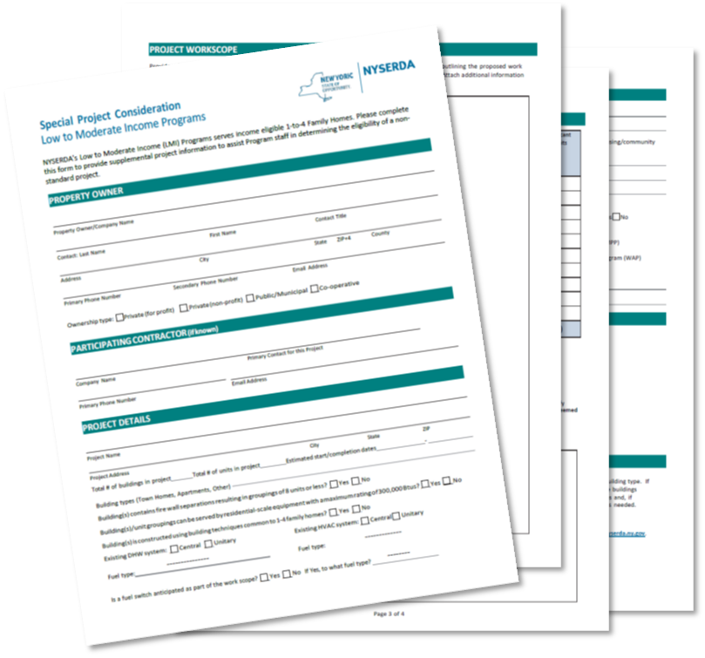
Other Program Updates
Non-Standard projects:
All non-standard projects should be submitted as Special Projects. Each request is reviewed by NYSERDA for eligibility with follow-up conducted by the Program Implementer, CLEAResult.
Steps:
Complete Special Project Consideration form
Email to NYSERDA (Erik.Gilbert@nyserda.ny.gov)
Program will contact Contractor if additional information is needed
Program makes final determination on eligibility and incentive amount
Approved projects will include instructions for Uplight submission

Slide 41
Additional Resources

Slide 42
Additional Resources
Follow-Up Sessions:
A follow up meeting-time has been scheduled for Participating Contractors to answer questions, etc. for July 22, from 9:00AM -10:00AM.
Register: https://nyserdany.webex.com/nyserdany/onstage/g.php?MTID=e0c99e0a10509d11f0b5388bd3b677ce4
Training Materials and Resources:
Participating Contractors Knowledge Base
Further Support:
Please reach out to Contractor Support at 800-284-9069 or support.residential@nyserda.ny.gov if you have questions.

