Slide 1

The Empire Building Challenge
Partner Case Study
Notes:
Michael to start at 3:32
Welcome to Empire Building Challenge. We are very excited to work with each and every one of you to achieve the following four goals

Slide 2
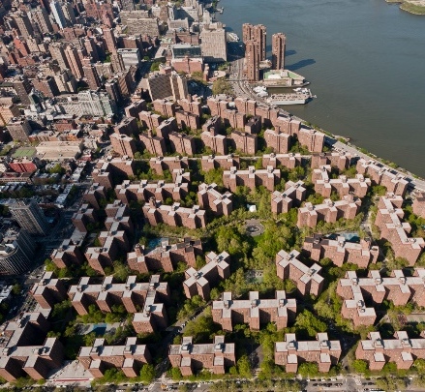
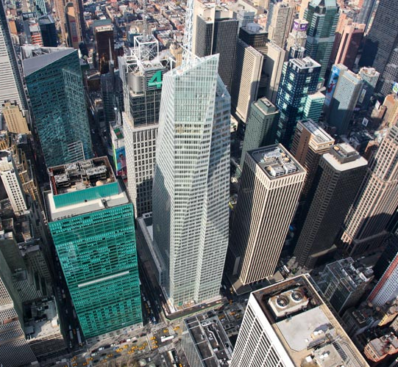
Empire Building Challenge
A $50 million NYSERDA investment to:
Accelerate private sector commitment and investment in carbon reduction, working with large portfolio owners.
Enable replication and scale across NY’s existing large commercial/multifamily building stock.
Make NY a global hub for low carbon retrofits.
Drive innovation to meet the needs of NY’s large commercial/multifamily building stock.
Notes:
Empire Building Challenge Program
The Empire Building Challenge is a NYSERDA-led public-private partnership that supports real estate portfolio owners of tall buildings in their effort to achieve carbon neutrality, while fostering partnerships between owners and the world's’ most innovative technology developers, manufacturers, and solution providers. A multifaceted approach to research, design, and planning will deliver low-carbon retrofit projects that demonstrate replicable and scalable solutions to reduce buildings' energy consumption and greenhouse gas emissions across New York State.

Slide 3
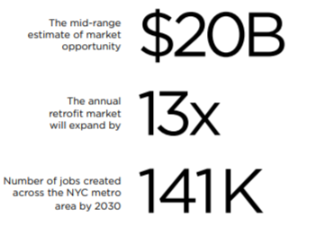
Low Carbon Retrofits Unlock Climate Progress
NYC: 3 billion square feet of existing office, multifamily buildings
~70% of today’s buildings constructed prior to energy code
~90% of today’s buildings will still be in operation in 2050
Buildings account for ~45% of NYS energy-related greenhouse gas emissions
Low Carbon Retrofits: Highlight on NYC Market Opportunity
Source: Urban Green Council, Retrofit Market Analysis 2019

Slide 4
Low Carbon Playbooks
In 2020, Vornado, The Durst Organization, Hines and Empire State Realty Trust partnered with NYSERDA to conduct in-depth analysis of their buildings.
The animating question is: What are the retrofit pathways that transition this building to carbon neutrality and are economically and technically viable?
What follows is the answer from the Hines team.

Slide 5

Playbook Partner

Slide 6



Established in 2015, Hudson Square Properties (HSP) is a joint venture of Trinity Church Wall Sreet, Norges Bank Investment Management and Hines. Together, Hudson Square Properties owns and manages a 12-building portfolio of approximately 6 million square feet in lower Manhattan.
Hines is a privately owned global real estate investment firm founded in 1957 with a presence in 255 cities in 27 countries. Hines oversees investment assets under management totaling approximately $83.6 billion¹. In addition, Hines provides third-party property-level services to more than 367 properties totaling 138.3 million square feet. Historically, Hines has developed, redeveloped or acquired approximately 1,486 properties, totaling over 492 million square feet. The firm currently has more than 171 developments underway around the world. With extensive experience in investments across the risk spectrum and all property types, and a foundational commitment to ESG, Hines is one of the largest and most-respected real estate organizations in the world.
¹ Includes both the global Hines organization as well as RIA AUM as of June 30, 2021

Slide 7
Commitment to Carbon Neutrality
Carbon neutrality elements are currently implemented in the firm's portfolio, most notably at 555 Greenwich, which is forecasted to achieve carbon emissions reductions 45% lower than New York City’s 2030 targets for office buildings. The project is also designed to align with a 1.5ºC pathway while meeting the state’s 2050 carbon neutral targets. It is expected to be one of the most sustainable buildings in the city and is one of Hines’ pilot projects in the firm's formative embodied carbon reduction initiative.
Hudson Square Properties has pledged one of its buildings – 345 Hudson – to reach carbon neutrality by 2032.
  The building will reduce its site Energy Use Intensity (EUI) by 69% from 2010 EUI level by 2032. The EUI of the building in 2010 was 126 kbtu/SF, and by 2032, Hines commits to reduce the EUI to 40 kbtu/SF.
Hines recently promoted Mike Izzo to Vice President-Carbon Strategy to lead the firm in assessing its global carbon emissions and develop the strategy to set and achieve the firm’s science-based targets.

Slide 8
The Team

Slide 9


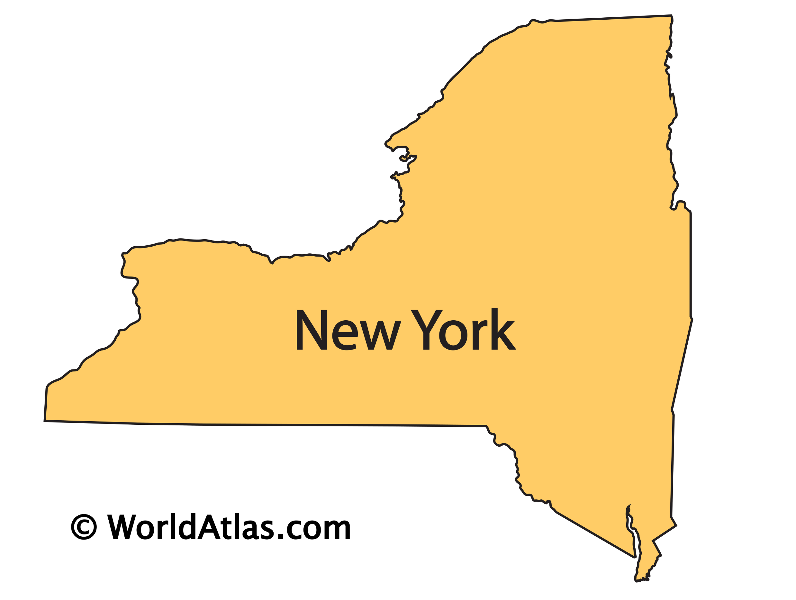


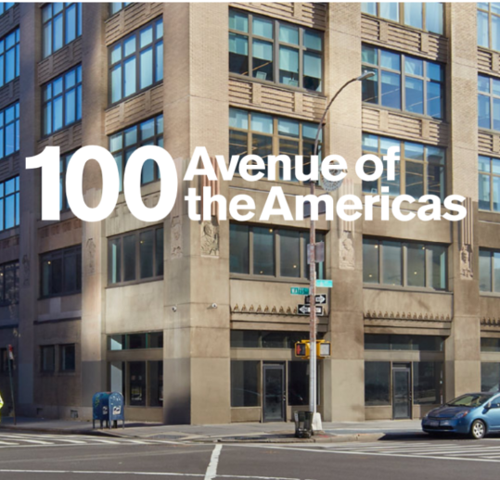
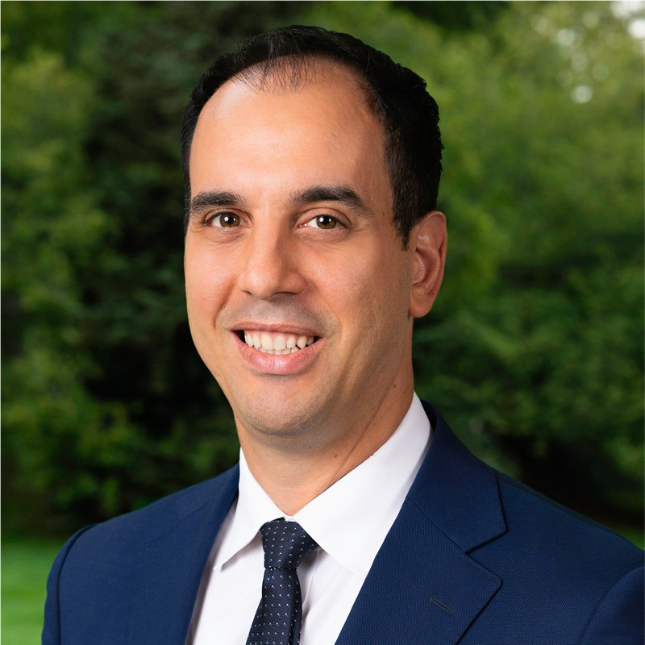




Mike Izzo, vice president carbon strategy in Hines' New York office led the study. He assembled a team comprising experts from:
URBS │ Urban Systems, a Stockholm, Sweden-based mechanical engineering firm that focuses on sustainable HVAC design
van Zelm Heywood & Shadford of Hartford, Connecticut, which specializes in water-based HVAC solutions
Thornton Tomasetti, a multi-disciplinary engineering firm known for its advanced building simulation techniques
Mike Izzo
VP
Carbon Strategy
Hines
Alonso Dominguez
Sr. Pr. Engineer
Thornton Tomasetti

Slide 10
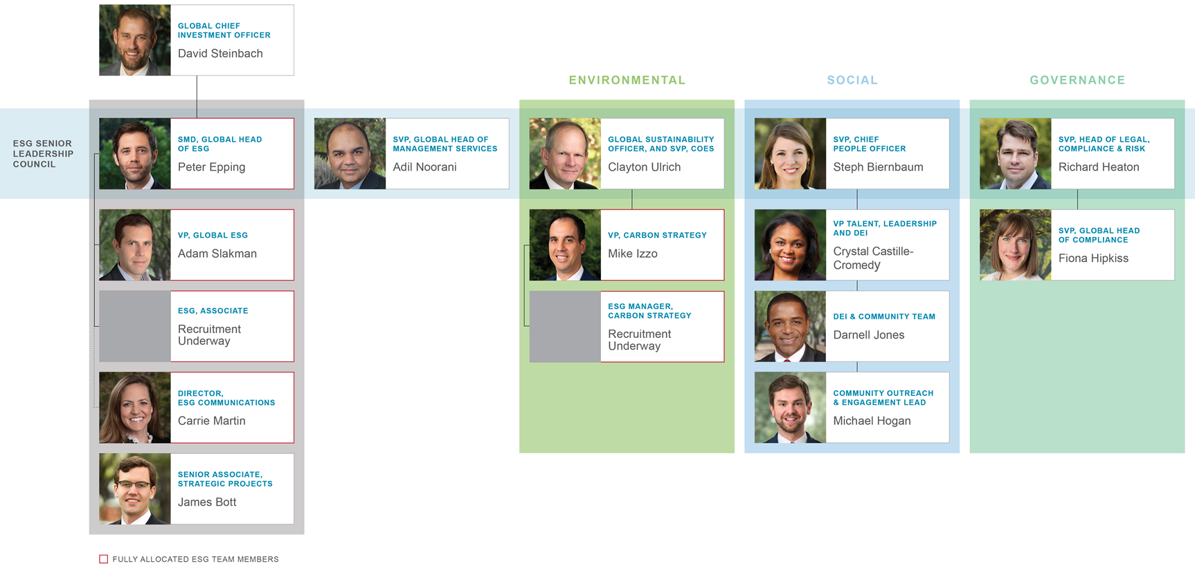
Hines' Sustainability Team

Slide 11

The Building

Slide 12
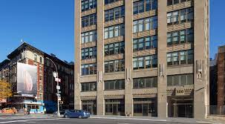
100 AoA Overview
Built in 1923, the 17-story masonry building structure is representative of many of New York City’s commercial buildings.
It has an uninsulated façade, double-pane windows and inefficient heating, cooling and ventilation systems that are prime for replacement.

Slide 13
100 AoA Building Energy Attributes
COOLING: Most floors are cooled by two 30-ton air-cooled AC units. The efficiency at which these units operates generally declines over time. Currently it is estimated that these units operate at a coefficient of performance of 2.5, meaning that for every unit of energy supplied to the unit, 2.5 units of cooling come out. Newer units can operate at a COP of 3-4, using 20%-60% less energy to provide the same amount of cooling
HEATING: The perimeter of 100 AoA is lined with steam radiators which compensate for thermal losses through the wall system. The steam radiators are fed from two 12,000 MBH gas-fired boilers which were installed in 1989. The boilers are approximately 80% efficient on paper but appear to be operating closer to 65%. By comparison modern condensing gas boilers operate at up to 95% efficiency and heat pumps operate at 300% efficiency, producing more energy than they consume.
FAÇADE: Like most existing commercial buildings in NYC, the facade of 100 AoA is uninsulated. The building underwent a window renovation roughly 10+ years ago where original single-pane glazing was replaced with double-pane glazing housed in thermally broken frames. While the new glazing system retains heat better than the original windows, the window system is not considered efficient.

Slide 14
What is the plan to reach carbon neutrality?
Follow these simple design principles
Data - Modeling
Electrify Heating
Ambient Water
Reduce Waste Energy
Energy Storage
1
2
3
4
5
Understanding the needs of the building | Electrify heating with high COP equipment, heat pumps | Use only the temperature water required to satisfy the indoor comfort and conditions, not any hotter or any colder | Capture the heat that is already being discarded within a building | Store the excess heat for use at a later time when needed

Slide 15
The Analysis

Slide 16
Proving that electric-based approaches can work
Until recently the technology to efficiently electrify heating systems hadn’t been readily available in the U.S. Using 100 AoA as the test bed, the team set out to prove that electric-based approaches could work.
The team evaluated existing and emerging technologies, honing in on three systems:
Active chilled beams with a heat pump
Active chilled beams, heat pump and radiant floor system
A hybrid variable refrigerant flow.
The first two can be built with off-the-shelf parts, while the third, which has been in use in Scandinavia and Japan for more than a decade, will be available in the U.S. within the next year.
The results for all of the options were better than expected: load sharing is not only possible but could virtually eliminate the need for gas heating in New York’s buildings, making decarbonization possible.

Slide 17
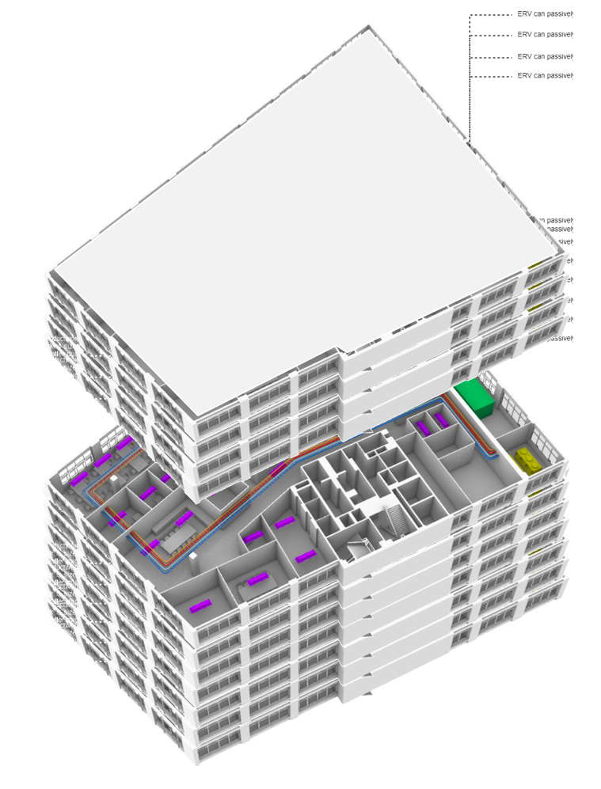
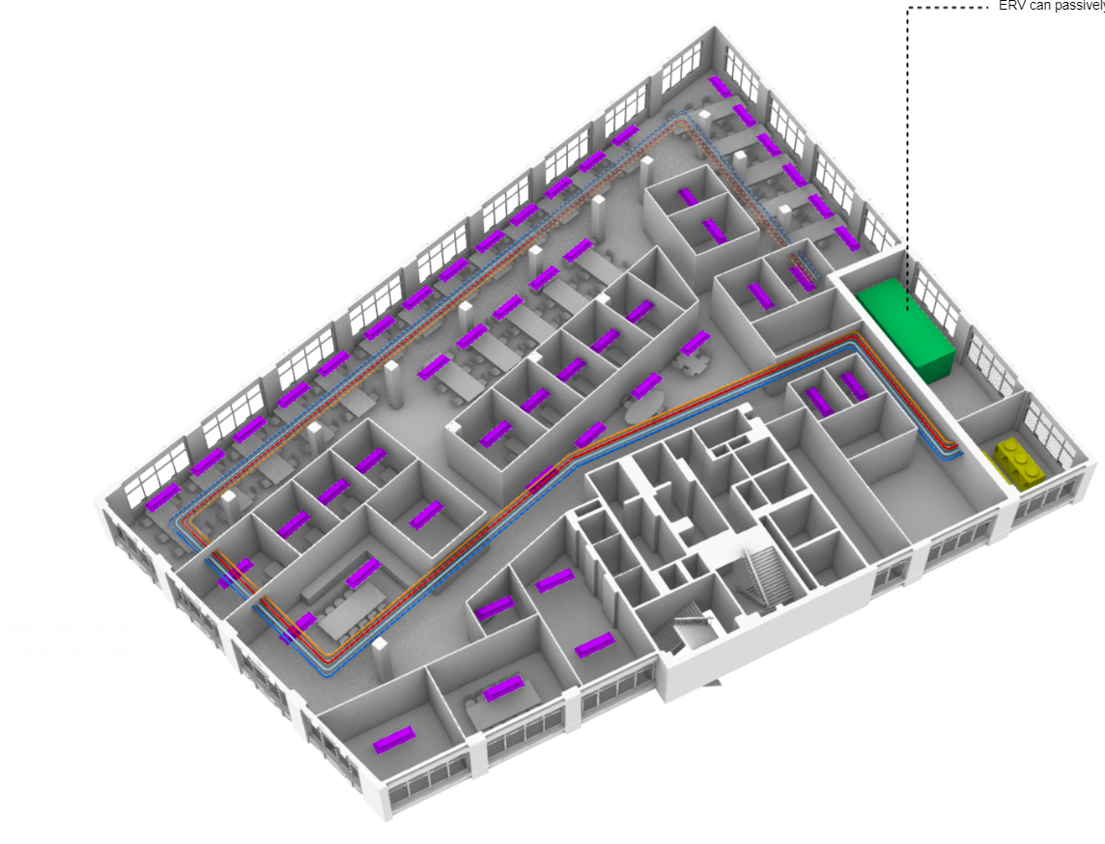
New systems can be phased in over time
TWO SCALES OF REFURBISHMENT
Rather than retrofitting the entire building, work can be done on a floor-by-floor basis, which is easier on the budget, allows for greater scheduling flexibility and is less disruptive to existing tenants.
It is estimated that full-floor tenants vacate spaces every 10 to 15 years, providing ample opportunities for upgrades before the city’s 2050 deadline.
SINGLE FLOOR RENOVATION
WHOLE BUILDING RENOVATION

Slide 18
Energy flows
All three methods rely on a single central heating/cooling machine that can transfer energy between returning hot and cold water streams simultaneously. The machines use a vapor-compression cycle, like that of a residential air conditioning unit, which runs in reverse.
Rather than cooling a space by pushing heat outdoors, it transfers the heat into another area of the building.

Slide 19
A more circular approach
New York City’s aging commercial buildings can be high-performing and sustainable by taking a few simple steps:
Leverage heat recovery ventilation to reduce conditioning loads.
Separate fresh air delivery from heating and cooling systems by using a dedicated outdoor air supply.
Recycle existing sources of heat within the building during the cold weather rather than rejecting it to the atmosphere.
Utilize heat pumps to satisfy remaining heating loads in buildings and fully eliminate the use of fossil fuel combustion.

Slide 20
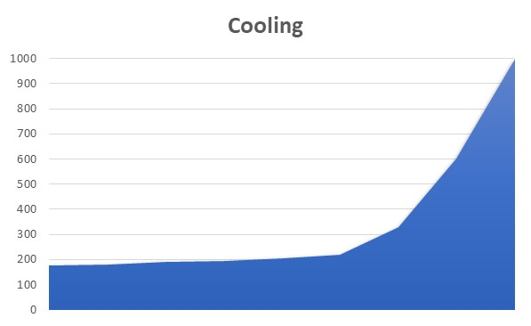
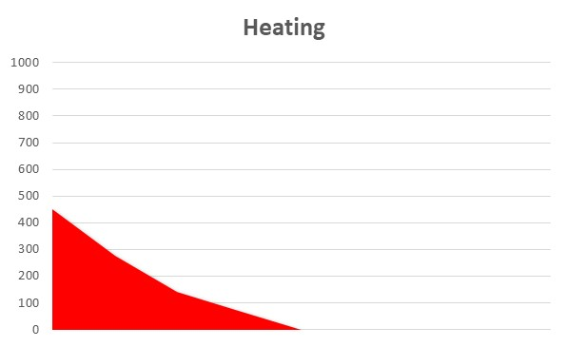
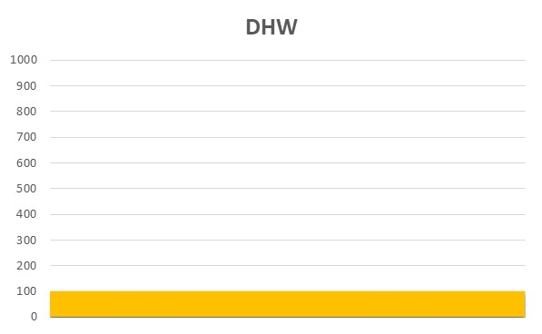
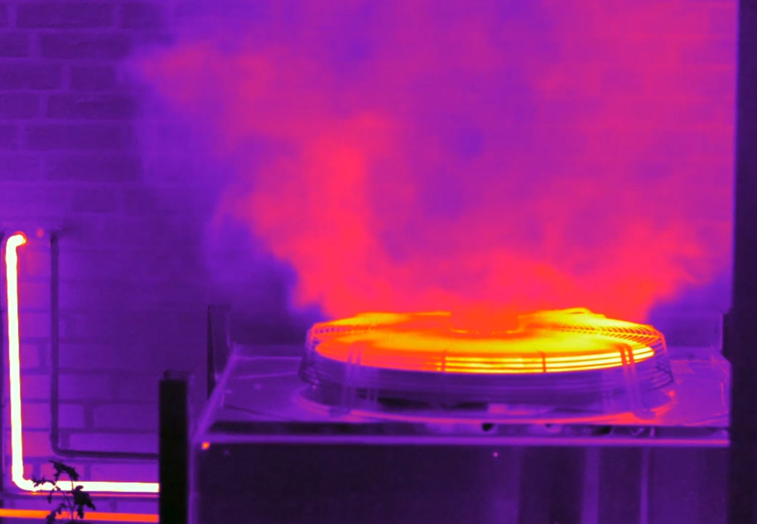

CURRENT SYSTEM SILOS
Individual Peak Demand
5x less efficient
Constant Heating Need
Notes:
40% of NYC’s existing commercial buildings are over 100 years old. TT spent the past year studying 100 Avenue of the Americas with Hines to look at the potential to electrify their centenarian building portfolio. The NYSERDA funded study will be published as a ‘Playbook’ to electrify older buildings and will be available in 2021

Slide 21
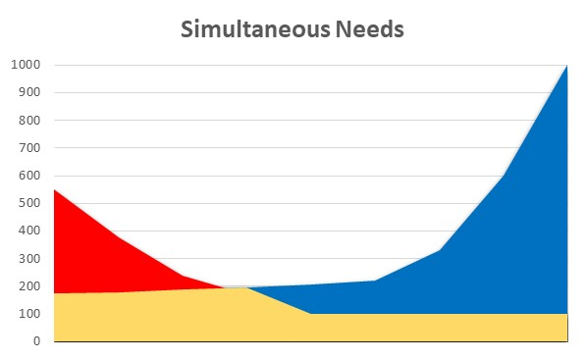
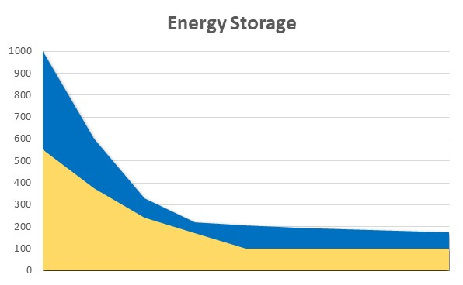


A MORE CIRCULAR APPROACH
Notes:
40% of NYC’s existing commercial buildings are over 100 years old. TT spent the past year studying 100 Avenue of the Americas with Hines to look at the potential to electrify their centenarian building portfolio. The NYSERDA funded study will be published as a ‘Playbook’ to electrify older buildings and will be available in 2021

Slide 22
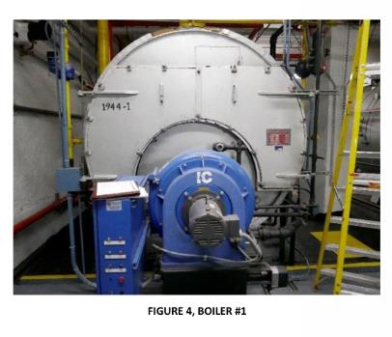
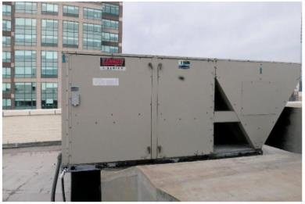
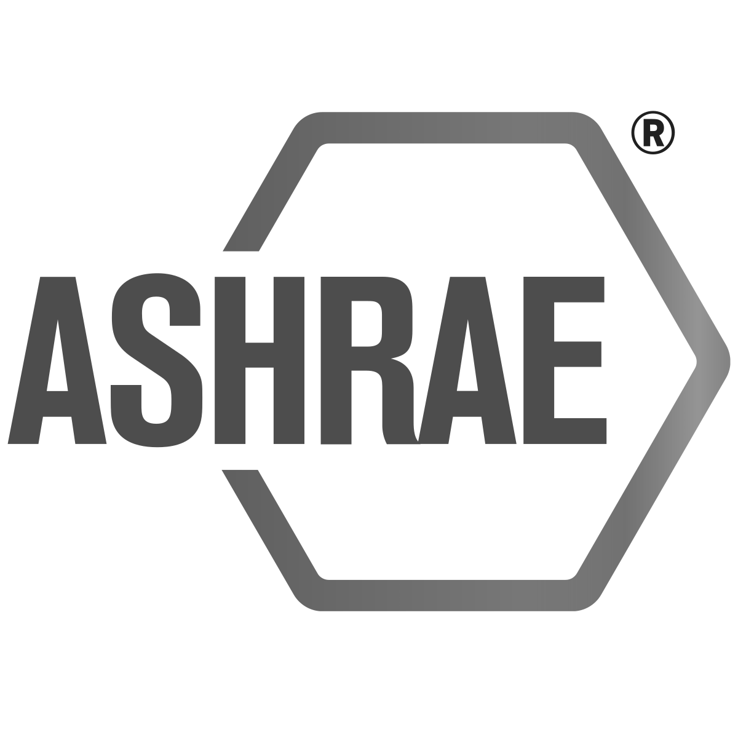

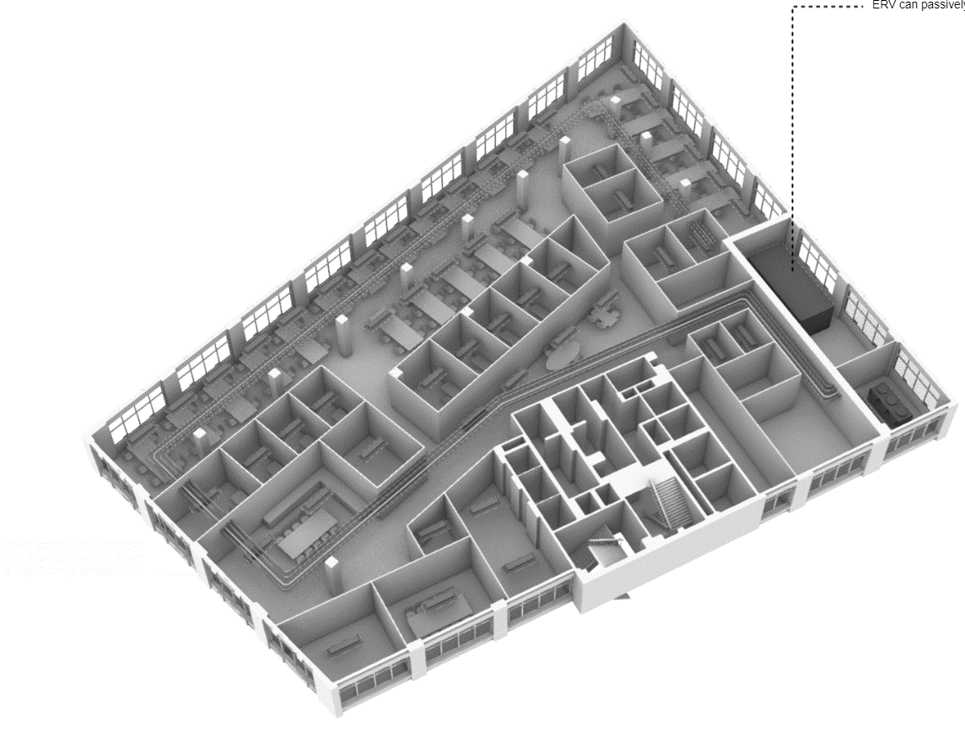

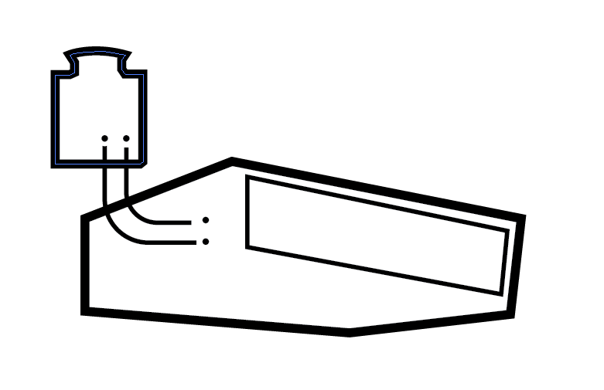


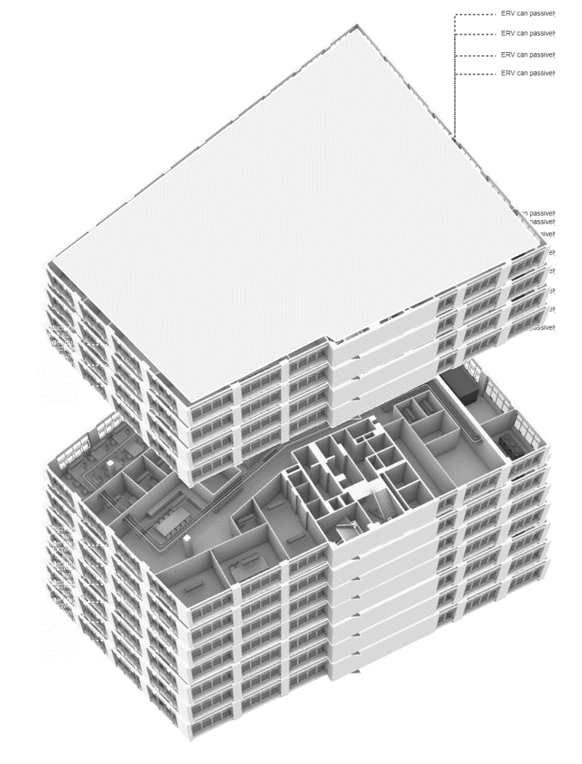
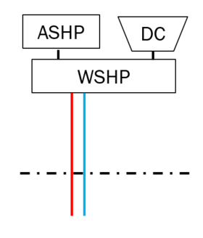
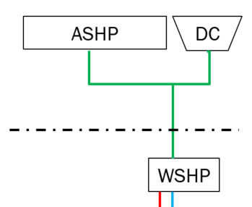
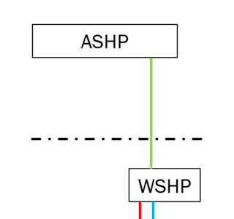
SYSTEMS OPTIONS
BASELINES
HYBRID VRF
AIR_SOURCE HEAT PUMP + ACTIVE CHILLED BEAMS
AIR_SOURCE HEAT PUMP + RADIANT SLAB
DISTRIBUTED WSHP + ACB
DISTRIBUTED WSHP + TAS
CENTRAL ASHP + ACB

Slide 23
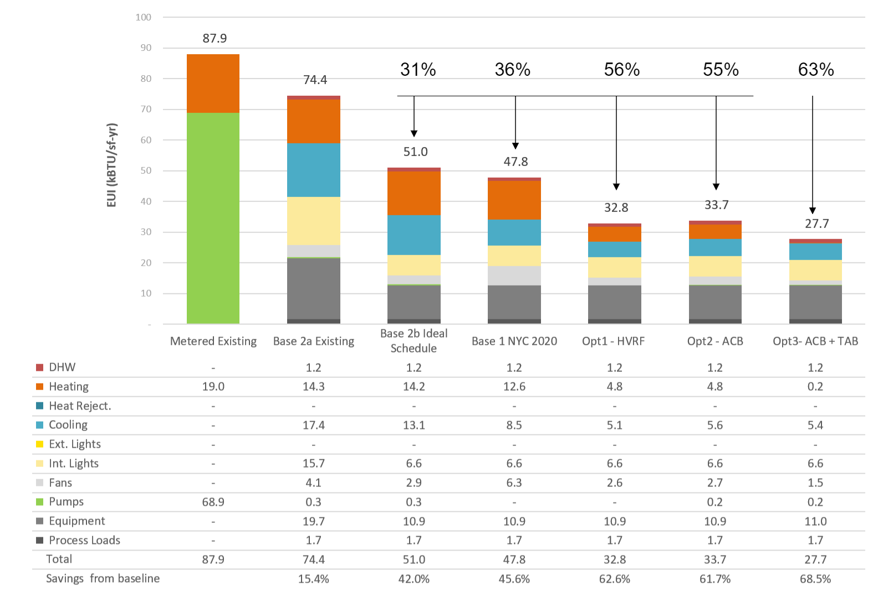
50-60% energy savings + no fossil fuels
RESULTS
EUIs ~30 kBtu/sf/yr

Slide 24
LL97 COMPARISON
2024 Limit
(8.46)
6.44
4.14
2030 Limit
(4.53)
3.90
2.97
2.76
29%
34%
44%
2.34
2050 Limit
(1.40)
Alternatives 25%+ below 2030 targets
With 70% renewables 2050 goals nearly met
At 74% Renewable Opt3 meets 2050 goals
*Assumptions: Zero Emissions Electricity (55% State Total)
Current: 90% Upstate - 21% Downstate (0.288 kg/KWh)
70% Renewables: 95% Upstate - 45% Downstate (0.206 kg/KWh)

Slide 25
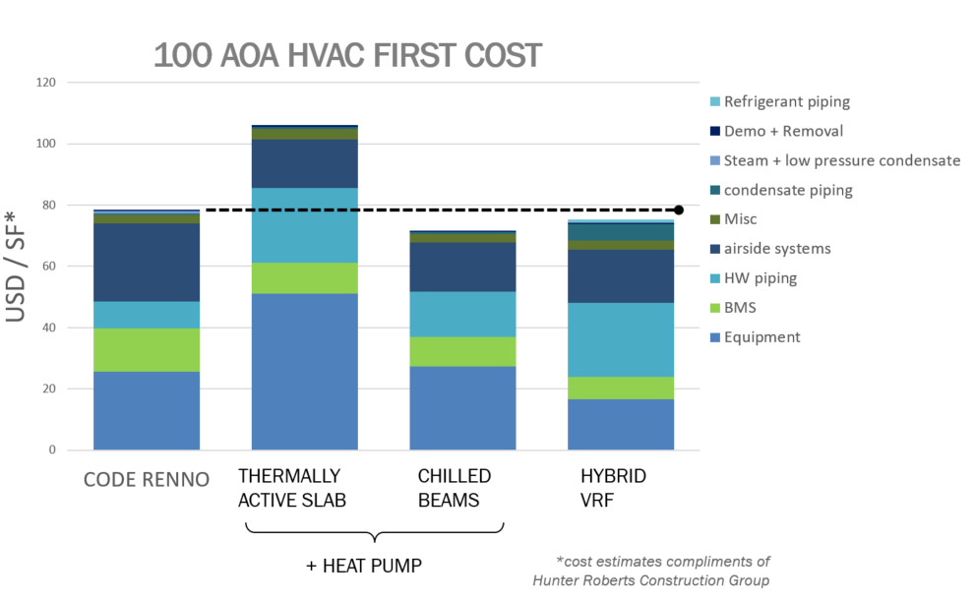
FIRST COST COMPARISON

Slide 26
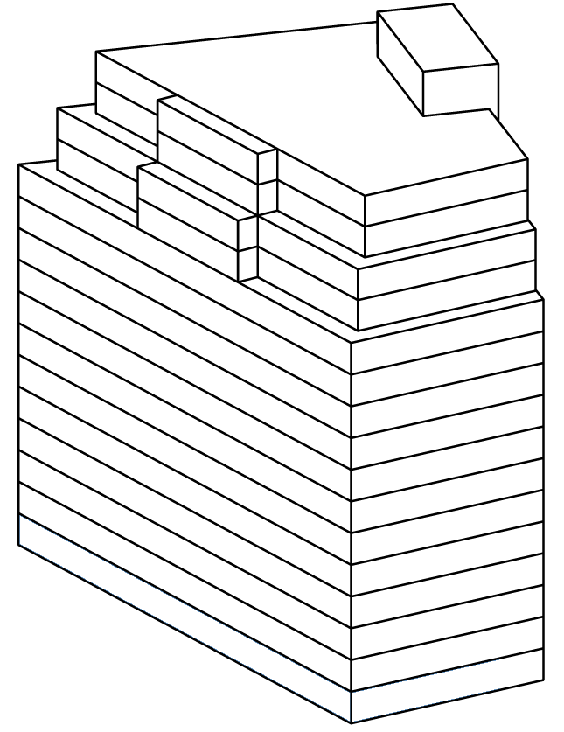
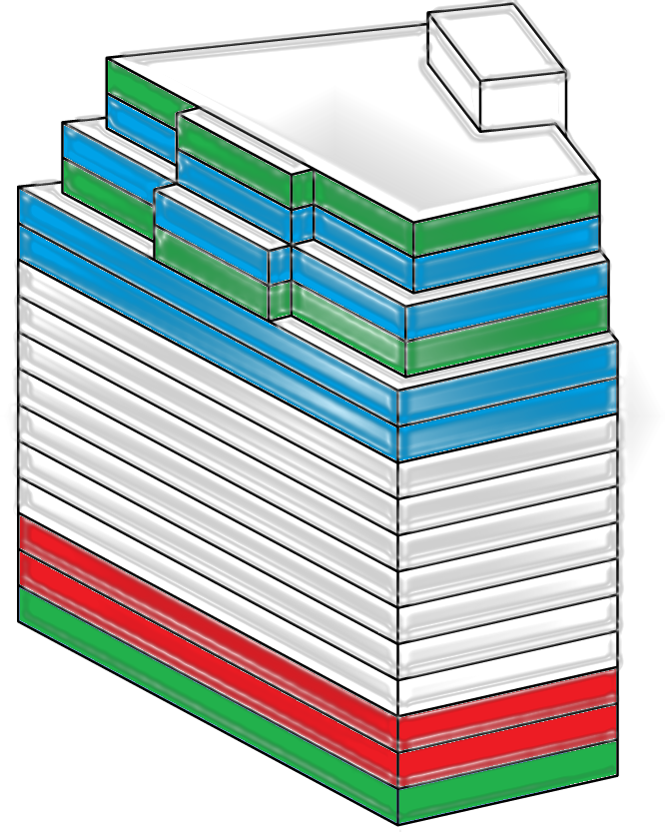
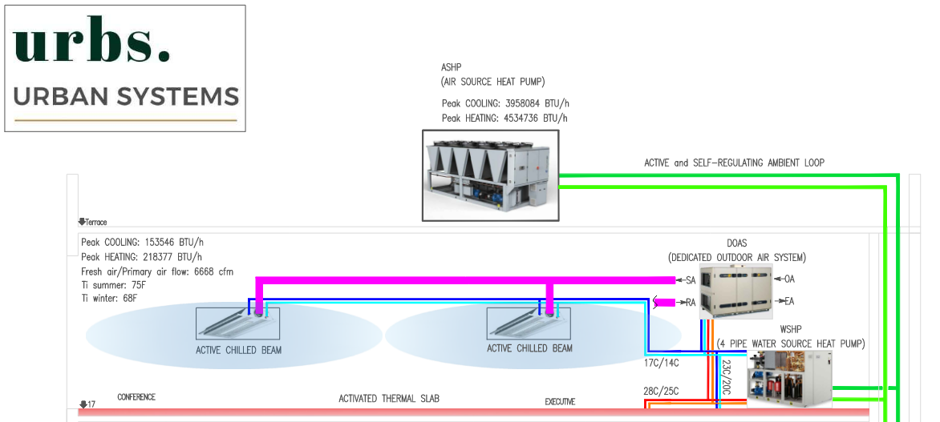
AMBIENT LOOP
T [˚F]
Avg. Outdoor Temperature
Operative Temperature
Loop Temperature
70
72
68
66
57
53
Self-Regulation
t [h]
Cooling
The ambient loop is used as a primary water circulation energy carrier using low temperature variations to keep steady state enthalpy to the sub-sources; heat pumps and chillers.
Cooling
Self-Regulation
Cooling
Cooling
Ambient conf.:
68˚F - 72˚F
725 kBtu/˚F
Heating
Heating
Self-Regulation

Slide 27
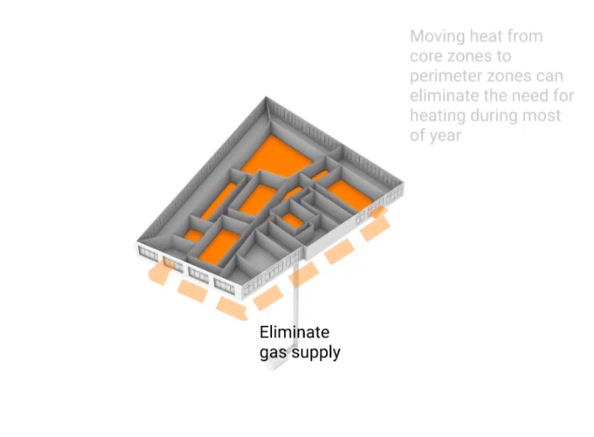
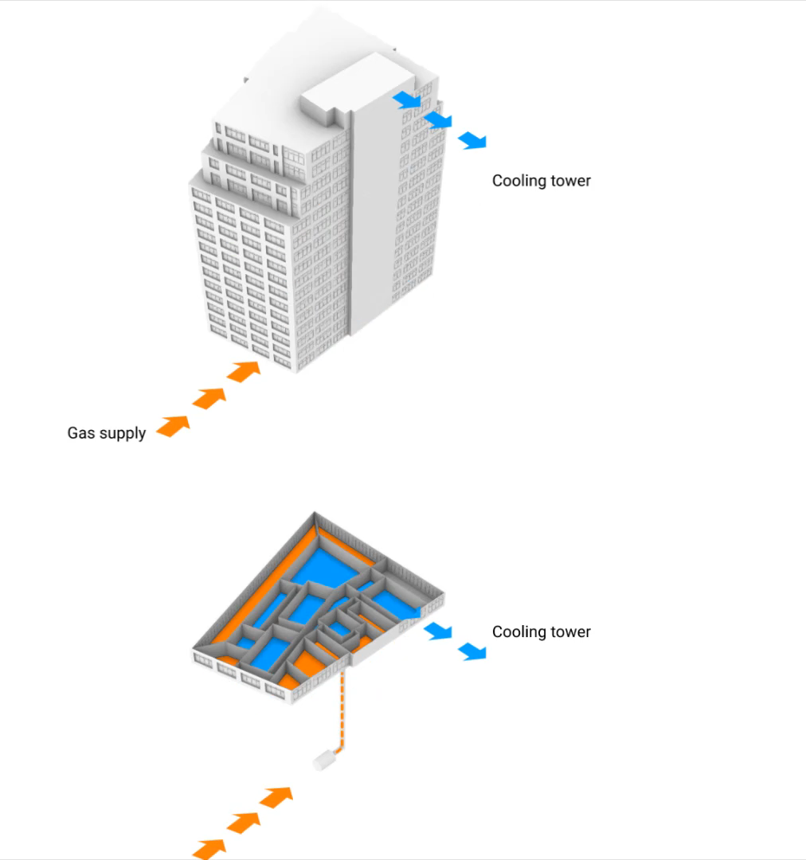
ELIMINATE FOSSIL FUELS + LOWER EUI
CURRENT PRACTICE
CURRENT OPPORTUNITY
Notes:
40% of NYC’s existing commercial buildings are over 100 years old. TT spent the past year studying 100 Avenue of the Americas with Hines to look at the potential to electrify their centenarian building portfolio. The NYSERDA funded study will be published as a ‘Playbook’ to electrify older buildings and will be available in 2021

Slide 28
Additional Technical Information

Slide 29
Strategy
Holistic Blank Canvas
Identify Constraints
Detailing
Financial Strategy
1
2
3
4
Bring experts together from the largest geographical and knowledge area to provide diverse holistic solutions | Identify financial and physical constraints to provide most efficient solutions | Narrow down options to provide best solutions for the particular problem | Provide a strategy that matches the financial plan for the building to phase out at the end of its useful life the fossil fuel equipment within the building

Slide 30
Analysis Process: 100 AoA
Established decarbonization goals and timeline
Assessed existing conditions
Developed calibrated energy model
Aligned on objectives
Designed & iterated
Prioritized measures/packages
Conducted financial analysis
Re-prioritization
Further analysis plus refinement . . . Iterate.

Slide 31
DESIGN PROCESS
9 Plant options
9 Distribution options
3 ventilation schemes
3 dehumidification options
5 HVAC CHARETTES
Full Design
Simulation
Pricing
OF

Slide 32
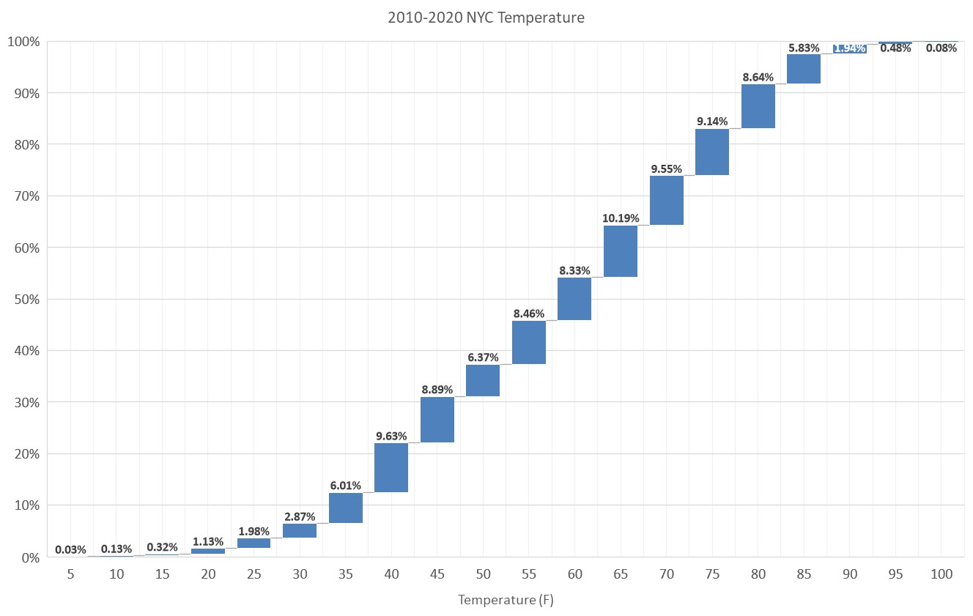
2010 - 2021 NYC Weather Data
Building systems and system architecture shall exploit part load design, not peak design
  Peak heating (0⁰F – 29⁰F) – 6.5% (5ºF - 36 hours, 10ºF 143 hours, 15ºF 343 hours out of 108,120)
  Heating + Cooling (30⁰F – 59⁰F) – 48%
  Moderate Cooling (60⁰F – 79⁰F) – 37.5%
  Cooling (80⁰F – 100⁰F) – 8%
Notes:
The heat generated in interior rooms of commercial spaces (server rooms, conference rooms) is sufficient to heat the remainder of the floor plate for the majority of the year. With load-sharing heatpumps carbon emissions can be brought within NYC’s 80x50 goals over the next 30 years

Slide 33
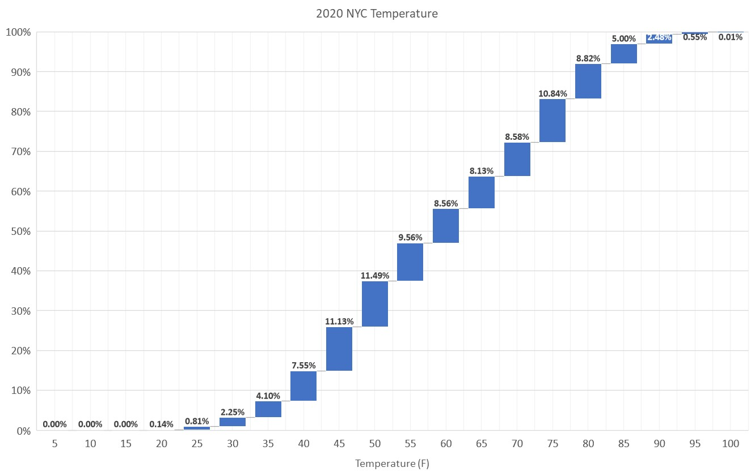
2020 NYC Weather Data
Building systems and system architecture shall exploit part load design, not peak design
  Peak heating (0⁰F – 29⁰F) – 3% (5ºF - 0 hours, 10ºF 0 hours, 15ºF 0 hours out of 8,784)
  Heating + Cooling (30⁰F – 59⁰F) – 53%
  Moderate Cooling (60⁰F – 79⁰F) – 36%
  Cooling (80⁰F – 100⁰F) – 8%
Notes:
The heat generated in interior rooms of commercial spaces (server rooms, conference rooms) is sufficient to heat the remainder of the floor plate for the majority of the year. With load-sharing heatpumps carbon emissions can be brought within NYC’s 80x50 goals over the next 30 years

Slide 34
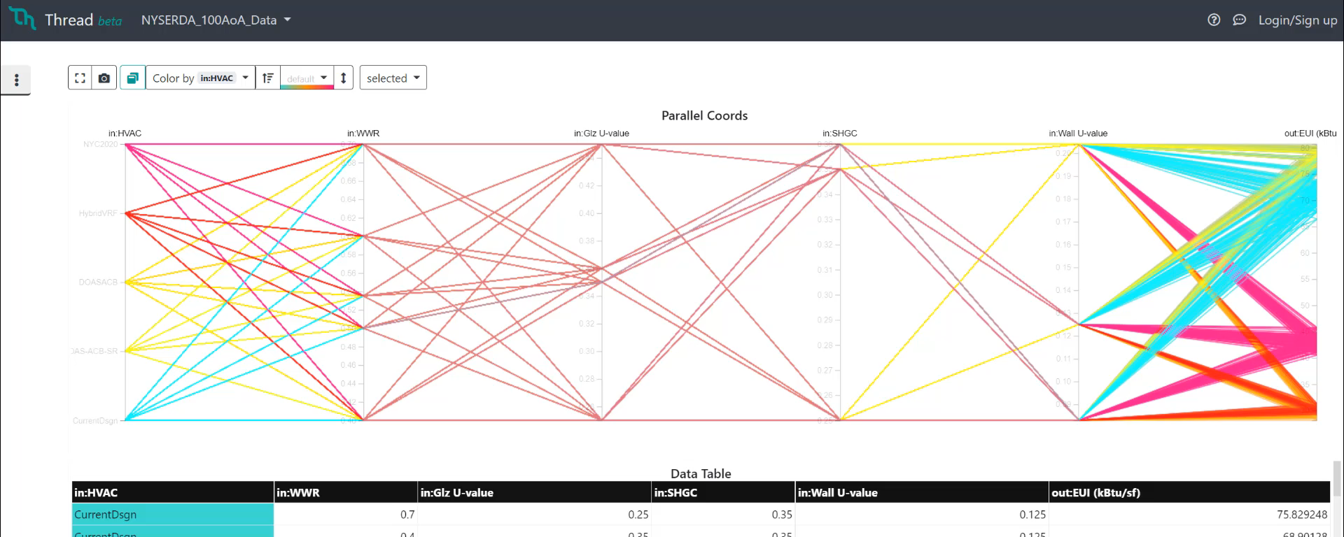
PARAMETRIC STUDIES
EUI
kBtu/sf/yr
VAV
70% WWR
80
H-VRF
70
60% WWR
60
ACB
50% WWR
50
40
Existing
40% WWR
30

Slide 35
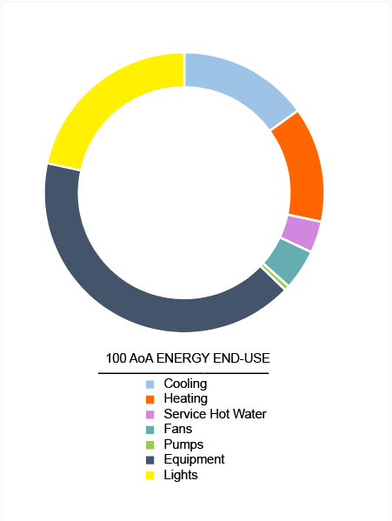
ANNUAL
ENERGY USE BREAKDOWN
30 kBtu/sf/yr
Notes:
The heat generated in interior rooms of commercial spaces (server rooms, conference rooms) is sufficient to heat the remainder of the floor plate for the majority of the year. With load-sharing heatpumps carbon emissions can be brought within NYC’s 80x50 goals over the next 30 years

Slide 36
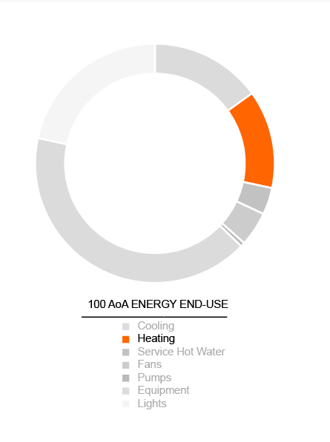
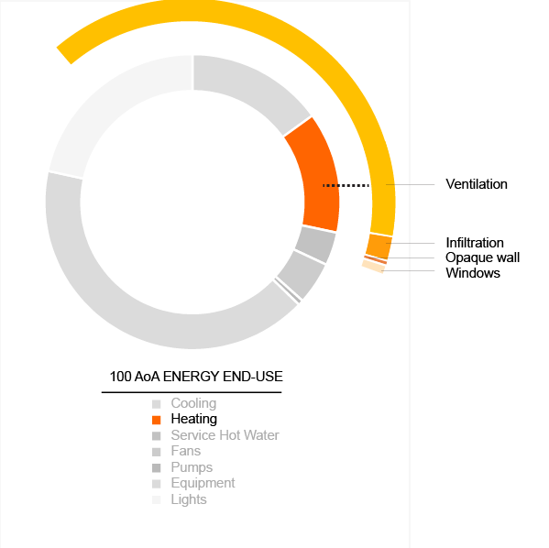
HEATING
PEAK HEATING
Heating accounts for 13% of annual energy use
The majority of heating needs come from the introduction of fresh air
Notes:
The heat generated in interior rooms of commercial spaces (server rooms, conference rooms) is sufficient to heat the remainder of the floor plate for the majority of the year. With load-sharing heatpumps carbon emissions can be brought within NYC’s 80x50 goals over the next 30 years

Slide 37
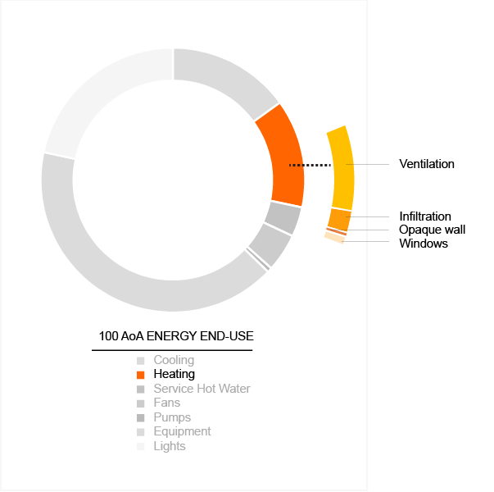
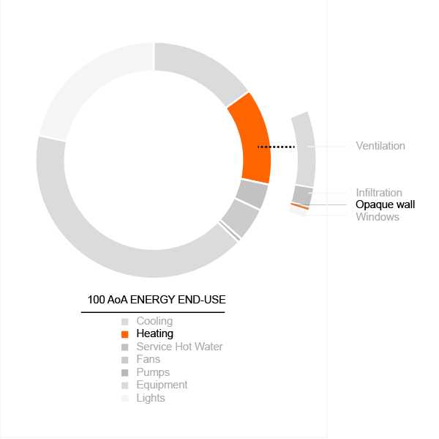
ADD HX%
ENVELOPE LOAD
A simple heat recovery wheel can reduce fresh air loads by 85%
Adding wall insulation has little benefit because it accounts for a fraction of the remaining heating load
Windows
Notes:
The heat generated in interior rooms of commercial spaces (server rooms, conference rooms) is sufficient to heat the remainder of the floor plate for the majority of the year. With load-sharing heatpumps carbon emissions can be brought within NYC’s 80x50 goals over the next 30 years

Slide 38
How did the team conduct this analysis?
FOCUS ON ENERGY FLOWS.
The fundamental principle of this project was a deep examination into the energy flows within commercial office spaces. While lights provide illuminance, they also give off heat. Office equipment and occupants behave much in the same way- they are essential dynamic components within the building program and have a thermal signature that a building’s heating and cooling systems must respond to. The analysis was based on examining opportunities to reuse/recycle/balance these flows via hydronic-based HVAC retrofits at multiple scales of renovation.

